Slide 1

Uncovering the Impact of FDA Accelerated Approval on Biotechnology Companies: An Economic Perspective
Catherine Nemeskal
October 11, 2025
Catherine Nemeskal | FDA Accelerated Approval

Slide 2
How do investors respond to FDA Accelerated Approval?
Research Questions
1
1
Catherine Nemeskal | FDA Accelerated Approval

Slide 3
Research Questions
How do investors respond to FDA Accelerated Approval?
What factors influence returns to biotechnology companies upon Accelerated Approval?
1
2

Slide 4
Research Questions
How do investors respond to FDA Accelerated Approval?
What factors influence returns to biotechnology companies upon Accelerated Approval?
How do investor reactions to Accelerated Approval differ from investor reactions to Standard Approval by the FDA?
1
2
3

Slide 5
Key Contributions
Assess the stock market reaction to Accelerated Approval decisions by the FDA

Slide 6
Key Contributions
Assess the stock market reaction to Accelerated Approval decisions by the FDA
Accelerated Approval has characteristics of both:

Slide 7
Key Contributions
Assess the stock market reaction to Accelerated Approval decisions by the FDA
Accelerated Approval has characteristics of both:
1
1
Early FDA action (FTD/BTD)

Slide 8
Key Contributions
Assess the stock market reaction to Accelerated Approval decisions by the FDA
Accelerated Approval has characteristics of both:
1
Early FDA action (FTD/BTD)
Standard FDA Approval (commercialization rights upon receipt)
2

Slide 9
Key Contributions
Assess the stock market reaction to Accelerated Approval decisions by the FDA
Accelerated Approval has characteristics of both:
1
Early FDA action (FTD/BTD)
Standard FDA Approval (commercialization rights upon receipt)
2
Direct comparison of stock market reaction to Accelerated vs. Full approval within one study

Slide 10
Literature Review
Early FDA Action
Fast Track Designation (FTD) and Breakthrough Therapy Designation (BTD): do not grant the opportunity to begin commercialization, but do provide increased FDA access FTD abnormal returns event studies:
Alefantis et al., 2004: 10.20% on t = 0
Miller, 2017: 3.89% over t = 0 to t = 1
BTD abnormal returns event studies
Re, 2016: 1.3% on t = 0
Wills, 2022: 6% on t = 0

Slide 11
Literature Review
Standard FDA Approval
Single approvals rarely impact stock prices, because approval likelihood is priced in throughout the development process (MacDonald, 2024)
Immediate abnormal returns event studies
Bosch & Lee, 1994: 0.42% on t = 0
Sharma & Lacey, 2004: 0.48% on t = 0, 0.88% on t = 1 Sarkar & De Jong, 2006: 0.35% on t = 0 - not significant

Slide 12
Data
Accelerated Approvals
328 AAs in FDA history
142 second indication Aas
81 AAs outside of selected time period (2010-2023)
29 AAs for companies not publicly traded on US markets
76 first-time AAs remain
Full Approvals
1808 standard approvals in selected time period (2010-2023)
705 priority / non-classified / accelerated approvals
939 second indications / formulations / manufacturers
87 approvals for companies not publicly traded on US markets
77 first-time standard approvals remain

Slide 13
Data
Daily stock price data from 2010-2023, daily S&P 500 returns, daily XBI returns, and annual market capitalization data obtained from CRSP
Missing market capitalization data calculated manually from SEC filings and historical stock price data
Fama French portfolio data obtained from WRDS
Drugs were classified into disease area with guidance from FDA disease categories and indication descriptions
Commercial status was determined through thorough search of press releases and SEC filings around event date

Slide 14
Accelerated Approval Summary Statistics
Commercial
Pre-Commercial

Slide 15
Accelerated Approval Descriptive Statistics
Oncology
Other Non-Oncology
Neurology
Metabolic
Bacterial

Slide 16
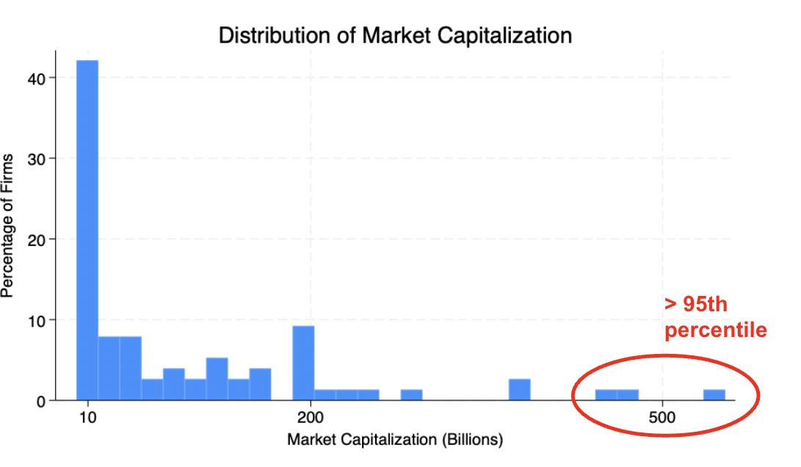
Accelerated Approval Summary Statistics

Slide 17
Accelerated Approval Summary Statistics
Mega-Cap
Large-Cap
Mid-Cap
Small-Cap
Micro-Cap

Slide 18
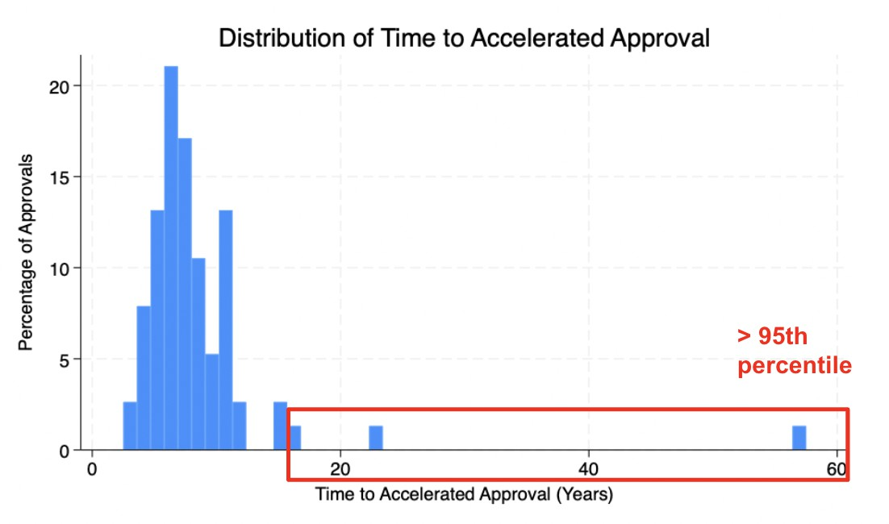
Accelerated Approval Summary Statistics

Slide 19
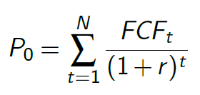
Model
Intrinsic value of a stock:

Slide 20

Model
Intrinsic value of a stock:
Free cash flow expectations are informed by net income, non-cash expenses, change in working capital, and capital expenditures:

Slide 21

Model
Intrinsic value of a stock:
Free cash flow expectations are informed by net income, non-cash expenses, change in working capital, and capital expenditures:
− CE_{t}
Net income expectations are informed by:

Slide 22

Model
In the biotechnology industry, revenue expectations for firm i
at time t are a function of:
S_{it} = company size
C_{it} = commercial status
D_{it} = disease area
U_{it} = unanticipated FDA action

Slide 23
Empirical Methodology | Market Model
Expected returns = linear function of market return
Market is proxied by both the S&P 500 and the XBI

Slide 24
Empirical Methodology | Market Model
Expected returns = linear function of market return
Market is proxied by both the S&P 500 and the XBI
OLS parameters estimated using 90-day period of daily returns prior to event window (t = -94, -4)

Slide 25
Empirical Methodology | Market Model
Expected returns = linear function of market return
Market is proxied by both the S&P 500 and the XBI
OLS parameters estimated using 90-day period of daily returns prior to event window (t = -94, -4)
Prediction window adopted from similar event studies assessing impact of early FDA action

Slide 26
Empirical Methodology | Market Model
Expected returns = linear function of market return
Market is proxied by both the S&P 500 and the XBI
OLS parameters estimated using 90-day period of daily returns prior to event window (t = -94, -4)
Prediction window adopted from similar event studies assessing impact of early FDA action
For each firm at each event date:

Slide 27
Empirical Methodology | Market Model
Expected returns = linear function of market return
Market is proxied by both the S&P 500 and the XBI
OLS parameters estimated using 90-day period of daily returns prior to event window (t = -94, -4)
Prediction window adopted from similar event studies assessing impact of early FDA action
For each firm at each event date:
R_{it} = rate of return for company’s stock price
α = average rate of return for company’s stock price over and above the benchmark
β_{it} = sensitivity of company’s stock returns to the market
R_{mt} = rate of return of the market SMB_{t}, HML_{t}, RMW_{t}, CMA_{t} = Fama French factors e_{it} = error term

Slide 28
Empirical Methodology | Abnormal Returns
1
Expected returns

Slide 29
Empirical Methodology | Abnormal Returns
1
Expected returns
OLS parameters (α, β , s, h, r , and c) used to predict each company’s expected ("normal") return during the event window (ER_{it} )

Slide 30

Empirical Methodology | Abnormal Returns
1
Expected returns
OLS parameters (α, β , s, h, r , and c) used to predict each company’s expected ("normal") return during the event window (ER_{it} )
Abnormal returns
2
2

Slide 31
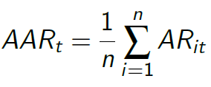
Empirical Methodology | Abnormal Returns
1
Expected returns
OLS parameters (α, β , s, h, r , and c) used to predict each company’s expected ("normal") return during the event window (ER_{it} )
Abnormal returns
AR_{it} = R_{it} − ER_{it}
Average abnormal returns
2
2
3
3
n = number of approval events

Slide 32
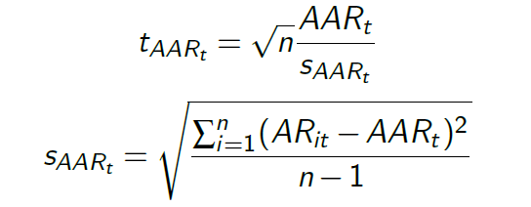
Empirical Methodology | Abnormal Returns
1
Expected returns
OLS parameters (α, β , s, h, r , and c) used to predict each company’s expected ("normal") return during the event window (ER_{it} )
Abnormal returns
AR_{it} = R_{it} − ER_{i}
Average abnormal returns
2
2
3
3
n = number of approval events
Abnormal returns statistical significance
4

Slide 33
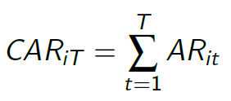
Empirical Methodology | Abnormal Returns
5
Cumulative abnormal returns

Slide 34
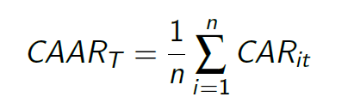
Empirical Methodology | Abnormal Returns
5
Cumulative abnormal returns
6
Cumulative average abnormal returns

Slide 35
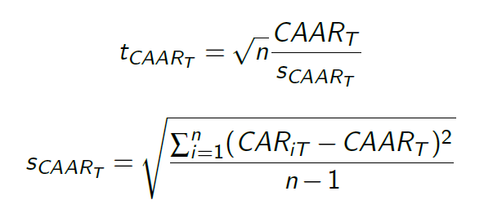
Empirical Methodology | Abnormal Returns
5
Cumulative abnormal returns
6
Cumulative average abnormal returns
7
Cumulative abnormal returns statistical significance

Slide 36
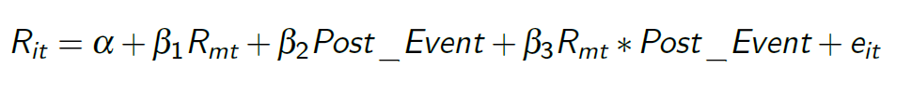
Empirical Methodology | Volatility
To evaluate whether volatility changes following an accelerated approval:

Slide 37
Empirical Methodology | Volatility
To evaluate whether volatility changes following an accelerated approval:
R_{it} = rate of return for company’s stock price
α = average rate of return for company’s stock price over and above the benchmark
β₁ = sensitivity of company’s stock returns to the market
R_{mt} = rate of return of the market
β₂ = difference in means in rate of return for company’s stock price before vs. after approval event
Post_Event = indicator variable for date being after the
approval event
β₃ = difference in sensitivity of company’s stock returns to the market before vs. after approval event
e_{it} = error term

Slide 38
Empirical Methodology | Volatility
To evaluate whether volatility changes following an accelerated approval:
R_{it} = rate of return for company’s stock price
α = average rate of return for company’s stock price over and above the benchmark
β₁ = sensitivity of company’s stock returns to the market
R_{mt} = rate of return of the market
β₂ = difference in means in rate of return for company’s stock price before vs. after approval event
Post_Event = indicator variable for date being after the
approval event
β₃ = difference in sensitivity of company’s stock returns to the market before vs. after approval event
e_{it} = error term
Event window: days t = -100 to t = 100

Slide 39
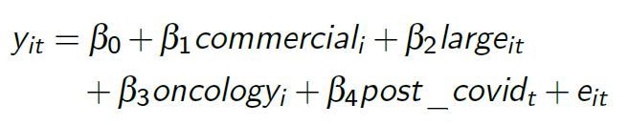
Empirical Methodology | Firm Characteristics
To evaluate the impact of company characteristics on returns around an approval event:
commercial_{i} = indicator variable for a company that has previously commercialized an in-licensed or self-made product large_{it} = indicator variable for a company having a market cap
> $10 billion
oncology_{i} = indicator variable for the approved product being in the oncology disease area
post_covid_{t} = indicator variable for the approval taking place
in 2020 or later
e_{it} = error term

Slide 40
Empirical Methodology | Firm Characteristics
To evaluate the impact of company characteristics on returns around an approval event:
commercial_{i} = indicator variable for a company that has previously commercialized an in-licensed or self-made product large_{it} = indicator variable for a company having a market cap
> $10 billion
oncology_{i} = indicator variable for the approved product being in the oncology disease area
post_covid_{t} = indicator variable for the approval taking place
in 2020 or later
e_{it} = error term
Analyzed ARs at day t = 0, 1 and CARs over days t = (-3, 3)

Slide 41
Empirical Methodology | Firm Characteristics
To evaluate the impact of company characteristics on returns around an approval event:
commercial_{i} = indicator variable for a company that has previously commercialized an in-licensed or self-made product large_{it} = indicator variable for a company having a market cap
> $10 billion
oncology_{i} = indicator variable for the approved product being in the oncology disease area
post_covid_{t} = indicator variable for the approval taking place
in 2020 or later
e_{it} = error term
Analyzed ARs at day t = 0, 1 and CARs over days t = (-3, 3)
Returns based upon S&P 500, including outliers

Slide 42
Approval processes are stable over time from 2010 to 2023
Identification Assumptions

Slide 43
Identification Assumptions
Approval processes are stable over time from 2010 to 2023
The returns during the 90-day prediction window are not influenced by the event itself, or other corporate events

Slide 44
Identification Assumptions
Approval processes are stable over time from 2010 to 2023
The returns during the 90-day prediction window are not influenced by the event itself, or other corporate events
I include a 4-day washout period to ensure the prediction window is not impacted by the event itself

Slide 45
Identification Assumptions
Approval processes are stable over time from 2010 to 2023
The returns during the 90-day prediction window are not influenced by the event itself, or other corporate events
I include a 4-day washout period to ensure the prediction window is not impacted by the event itself
No extraneous shocks to share price occur on the day of approval announcement and 3 days prior

Slide 46
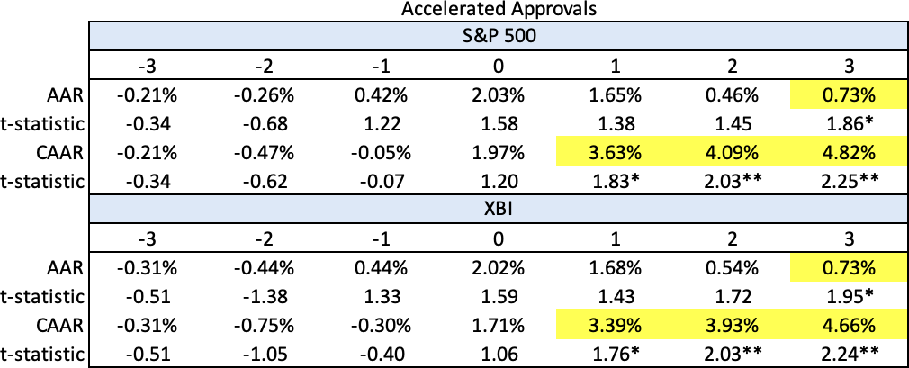
Empirical Results | Accelerated Approvals

Slide 47
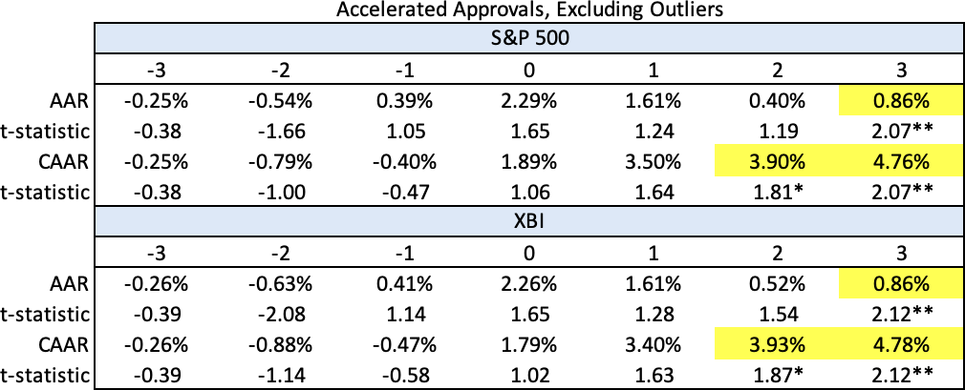
Empirical Results | Accelerated Approvals

Slide 48
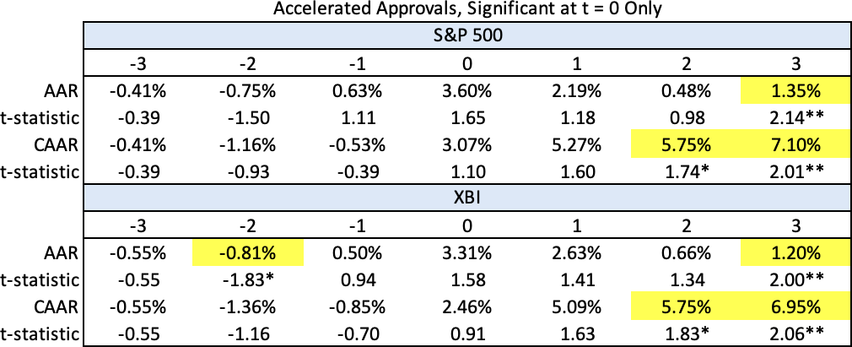
Empirical Results | Accelerated Approvals

Slide 49
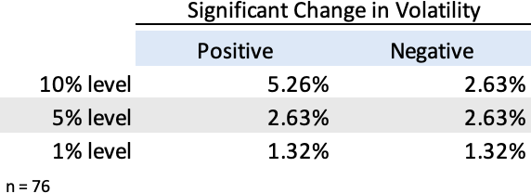
Empirical Results | Accelerated Approvals

Slide 50
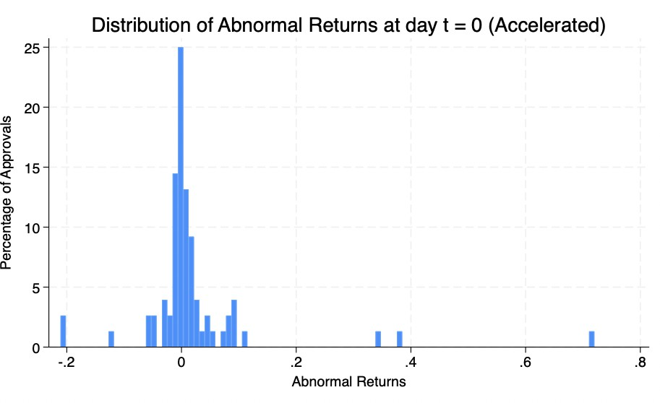
Empirical Results | Accelerated Approvals

Slide 51
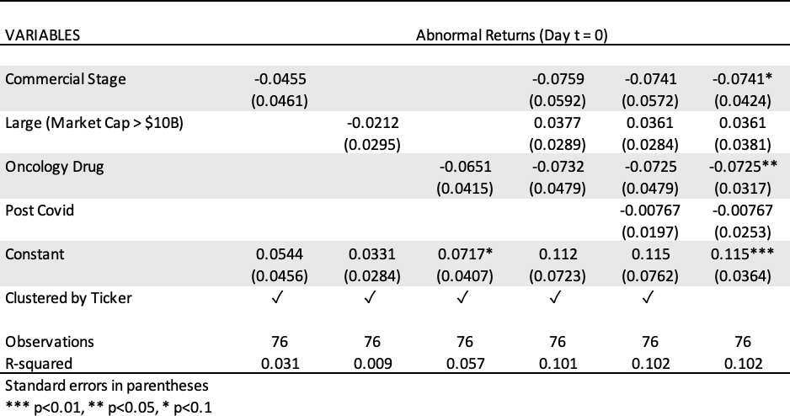
Empirical Results | Accelerated Approvals

Slide 52
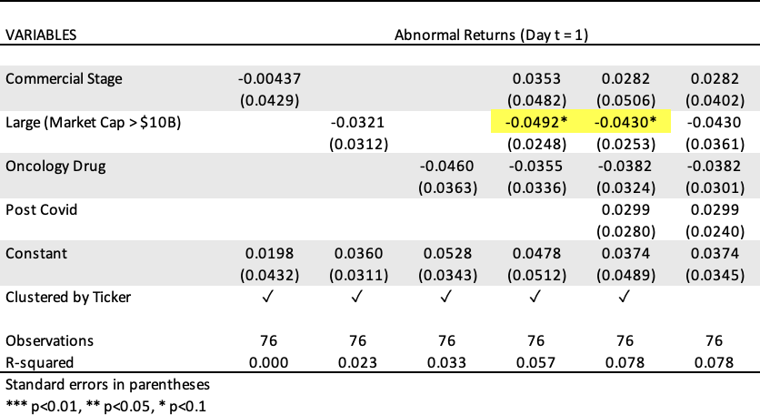
Empirical Results | Accelerated Approvals

Slide 53
Empirical Results | Accelerated Approvals

Slide 54
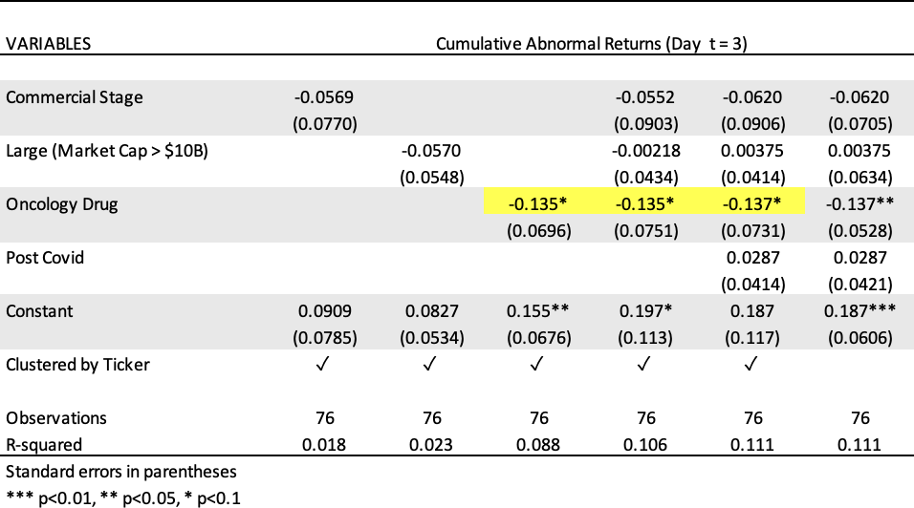
Empirical Results | Accelerated Approvals

Slide 55
Empirical Results | Accelerated Approvals

Slide 56
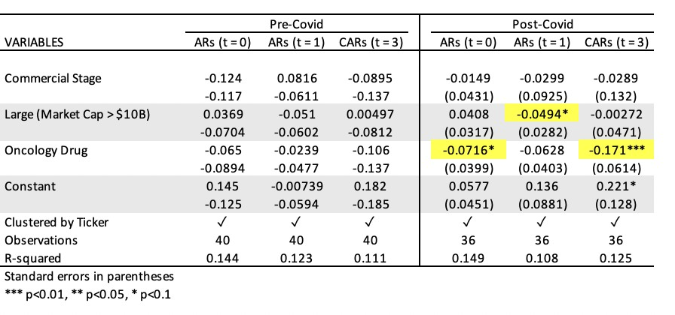
Empirical Results | Accelerated Approvals

Slide 57
Empirical Results | Full vs. Accelerated Approvals

Slide 58
Empirical Results | Full vs. Accelerated Approvals

Slide 59
Empirical Results | Full vs. Accelerated Approvals

Slide 60
Empirical Results | Conversion Status
Accelerated Approvals are either:
1
Converted to full approval
Withdrawn upon confirmatory study evaluation
2
76 AA events
31 not yet converted
32 conversion events
7 post-2023 conversions
2 converted approvals occurred after acquisition
23 conversion events remain for analysis
13 withdrawal events
3 post-2023 conversions
3 withdrawal events occurred after acquisition
7 withdrawal events remain for analysis

Slide 61
Empirical Results | Conversion Status

Slide 62
Empirical Results | Conversion Status
Converted
Withdrawn

Slide 63
Empirical Results | Conversion Status

Slide 64
Discussion
1
AA is associated with a positive abnormal return for biotechnology companies on the day of announcement
Statistically insignificant
Non-oncology drugs have significantly higher positive abnormal returns by 7.2 percentage points, relative to oncology drugs, after the COVID-19 pandemic
1

Slide 65
Discussion
1
AA is associated with a positive abnormal return for biotechnology companies on the day of announcement
Statistically insignificant
Non-oncology drugs have significantly higher positive abnormal returns by 7.2 percentage points, relative to oncology drugs, after the COVID-19 pandemic
AA is associated with a positive abnormal return for biotechnology companies on the day following announcement
Statistically insignificant
Small companies have significantly higher positive abnormal returns by 4.9 percentage points, relative to large companies, after the COVID-19 pandemic
2

Slide 66
Discussion
1
AA is associated with a positive abnormal return for biotechnology companies on the day of announcement
Statistically insignificant
Non-oncology drugs have significantly higher positive abnormal returns by 7.2 percentage points, relative to oncology drugs, after the COVID-19 pandemic
AA is associated with a positive abnormal return for biotechnology companies on the day following announcement
Statistically insignificant
Small companies have significantly higher positive abnormal returns by 4.9 percentage points, relative to large companies, after the COVID-19 pandemic
AA is associated with significant, positive cumulative abnormal returns over a 7-day event window over days (t = -3, 3)
Significant at the 5% level
Non-oncology drugs have significantly higher positive cumulative abnormal returns by 17.1 percentage points, relative to oncology drugs, after the COVID-19 pandemic
2
3

Slide 67
Discussion
4
AA does not significantly change stock price volatility

Slide 68
Discussion
4
AA does not significantly change stock price volatility
AA does not confer statistically different abnormal or cumulative abnormal returns than full approval
Suggests investors do not view the two approval methods as significantly different
5

Slide 69
Discussion
4
AA does not significantly change stock price volatility
AA does not confer statistically different abnormal or cumulative abnormal returns than full approval
Suggests investors do not view the two approval methods as significantly different
Though insignificant, cumulative abnormal returns are consistently higher for full approvals than accelerated approvals over a 7-day event window
Probability of downstream withdrawal may account for differences between these two groups
5
6

Slide 70
Limitations
Small sample size: the FDA only approves a finite number of drugs, for both full and accelerated approval
Limited statistical power
Small conversion and withdrawal samples
Limited firm variability: majority of FDA approved drugs are oncology drugs produced by large, commercial-stage companies Possible measurement error due to:
Possible confounding corporate events in prediction window

Slide 71
Future Research Directions
Assess long term cumulative abnormal returns following accelerated approval
AA may confer changes in investor perceptions not fully captured by the 7-day event window
Analyze a wider variety of approval strategies from the FDA i.e.) Priority status, approvals previously receiving FTD or BTD, etc.

Slide 72
References
Alefantis, T. G., Kulkarni, M. S., & Vora, P. P. (2004). Wealth effects of Food and Drug Administration" fast track" designation. Journal of Pharmaceutical Finance, Economics and Policy, 13(3), 41-53.
Bosch, J.-C., & Lee, I. (1994). Wealth Effects of Food and Drug Administration (FDA) Decisions. Managerial and Decision Economics, 15(6), 589â599.
Fama, E. F., & French, K. R. (2015). A five-factor asset pricing model. Journal of Financial Economics, 116(1), 1â22. https://doi.org/10.1016/j.jfineco.2014.10.010
MacDonald, P. (2024). The Impact of FDA Approvals on Healthcare Stocks. Harvest ETFs. https://harvestportfolios.com/the-impact-of-fda-approvals-on-healthcare-stocks/
Miller, K. L., Nardinelli, C., Pink, G., & Reiter, K. (2017). The Signaling Effects of the US Food and Drug Administration Fast-Track Designation. Managerial and Decision Economics, 38(4), 581â594. https://doi.org/10.1002/mde.2805
Re, S. E. (2016). Stock Market Reaction to FDA Breakthrough Therapy Designation [Dissertation, The Leonard N. Stern School of Business].
Sarkar, S. K., & de Jong, P. J. (2006). Market response to FDA announcements. The Quarterly Review of Economics and Finance, 46(4), 586â597. https://doi.org/10.1016/j.qref.2005.01.003
Sharma, A., & Lacey, N. (2004). Linking Product Development Outcomes to Market Valuation of the Firm: The Case of the U.S. Pharmaceutical Industry. Journal of Product Innovation Management, 21(5), 297â308. https://doi.org/10.1111/j.0737-6782.2004.00084.x
Williamson, J., & Spicer, A. J. (2023). Review of the impact of the FDAâs Fast Track Designation on biotechnology companiesâ share prices. Drug Discovery Today, 28(11), 103771. https://doi.org/10.1016/j.drudis.2023.103771
Williamson, J., Spicer, A. J., Louramo, E., & Jalkanen, J. (2024). Unveiling the impacts of FDA Breakthrough Therapy Designation: A dual-perspective examination of economic and developmental outcomes for biotechnology companies. Drug Discovery Today, 29(4), 103919. https://doi.org/10.1016/j.drudis.2024.103919
Wills, T. (2022). Breakthrough therapy designation: The real-world impact of structural novelty. https://www.cas.org/resources/cas-insights/breakthrough-therapy-designation-real-world-impact

Slide 73
THANK YOU!
Catherine Nemeskal | FDA Accelerated Approval

Slide 74
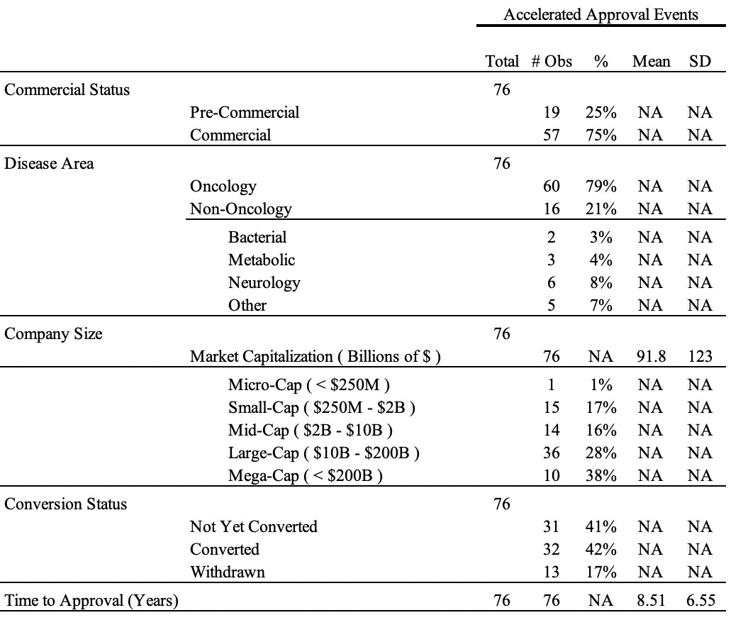
Appendix | AA Summary Statistics

Slide 75
Appendix | Accelerated AARs

Slide 76
Appendix | Accelerated CAARs

Slide 77
Appendix | Oncology vs. Non-Oncology, Pre vs. Post Covid

Slide 78
Appendix | Large vs. Small, Pre vs. Post Covid

Slide 79
Appendix | Oncology vs. Oncology, Pre vs. Post Covid

