Slide 1
Skilled Immigration and Business Diversity: Evidence from the H-1B Lottery
Spencer Ma
George Washington University
IAES Best Undergraduate Paper Award Competition
October 11, 2025
Spencer Ma
IAES BUPA Competition

Slide 2
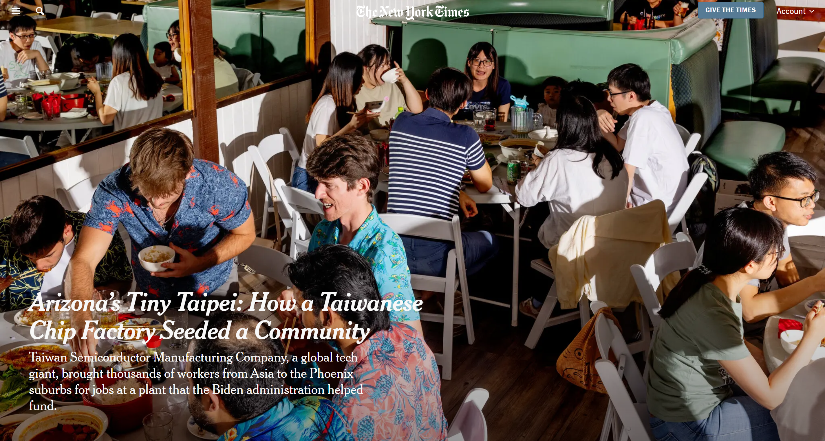
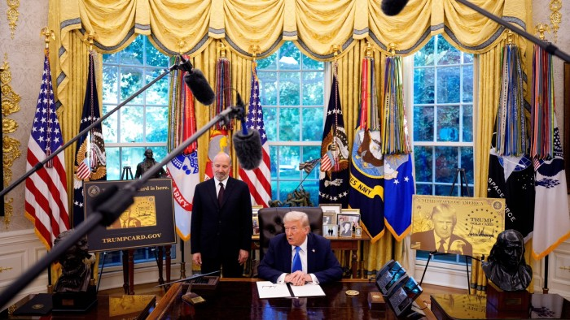
Motivation
H-1B Visa → primary channel for skilled immigration to the US
Prior literature on H-1B visa focuses on wages and productivity growth – positive effects found for both
I measure the effect of the H-1B visa on “business diversity”
Source: The New York Times
Source: The Financial Times
Spencer Ma
Skilled Immigration and Business Diversity
2
IAES BUPA Competition

Slide 3
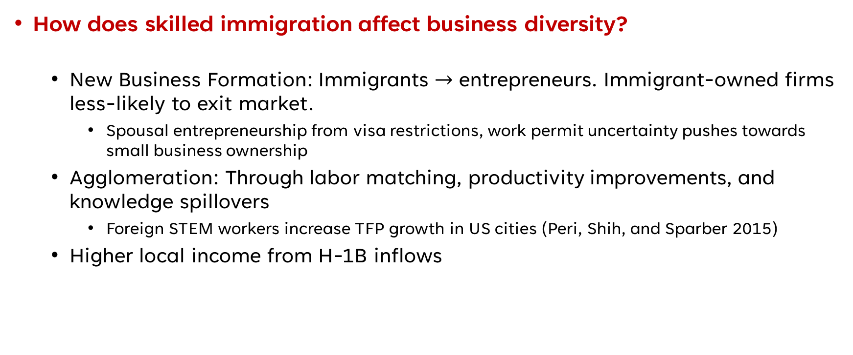
This Paper
How does skilled immigration affect business diversity?
New Business Formation: Immigrants $→$ entrepreneurs. Immigrant-owned firms less-likely to exit market.
Spousal entrepreneurship from visa restrictions, work permit uncertainty pushes towards small business ownership
Agglomeration: Through labor matching, productivity improvements, and knowledge spillovers
Foreign STEM workers increase TFP growth in US cities (Peri, Shih, and Sparber 2015)
Higher local income from H-1B inflows
Spencer Ma
Skilled Immigration and Business Diversity
3
IAES BUPA Competition

Slide 4
This Paper
This paper provides new evidence on the impacts of skilled immigration on business diversity (Herfindahl Hirschman Index).
Exploit the H-1B lottery as an exogenous source of variation.
Construct HHI measure from 2012-2022 County Business Patterns
Calculate H-1B lottery win rate by dividing winning H-1B Visa applications (USCIS data) by the total H-1B lottery applications (DOL LCA data)
Use continuous DiD to estimate the dose-response effect of an increase in skilled immigration on HHI
Spencer Ma
Skilled Immigration and Business Diversity
4
IAES BUPA Competition

Slide 5
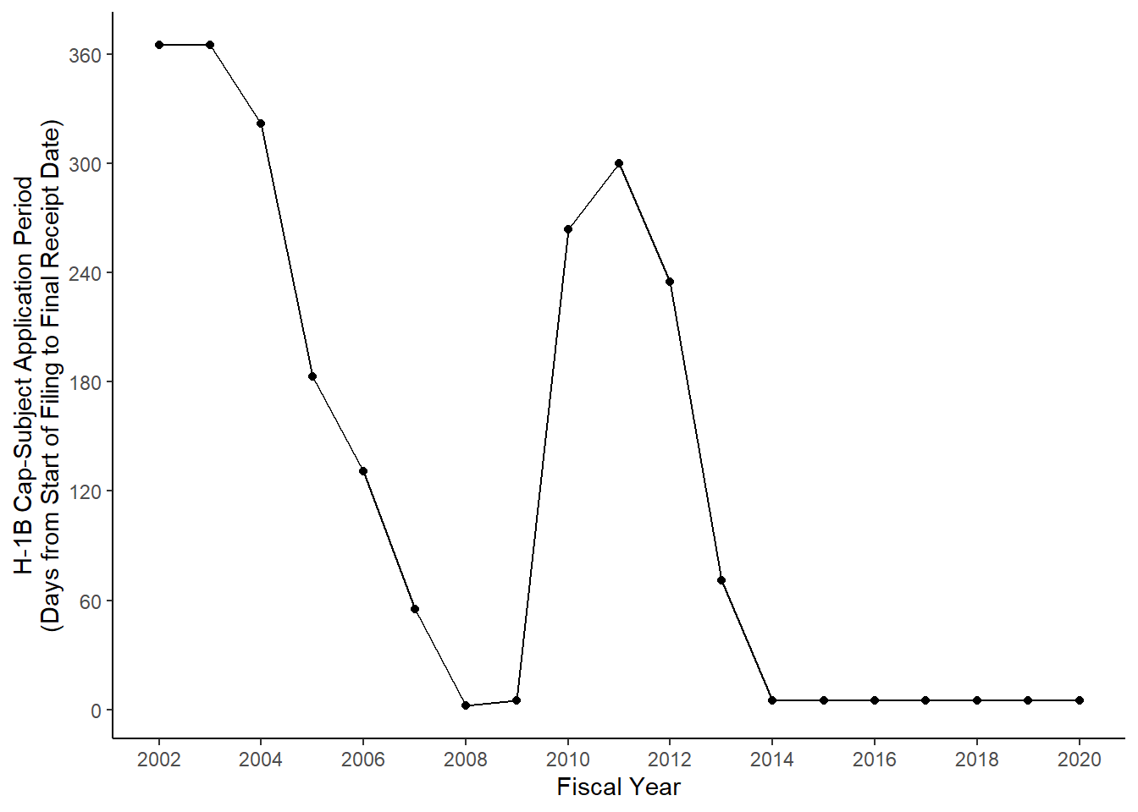
H-1B Lottery
Basics
Created under Immigration and Nationality Act (1990)
Annual cap of 85,000 visas
65,000 regular cap, 20,000 advanced degree exemption
Lottery vs Cap-Exempt
Nonprofit firms (universities, research, hospitals) cap exempt
Private for-profit firms subject to lottery
Lottery Mechanism
USCIS runs lottery ONLY when applications exceed cap
If cap exceeded in the first 5 days, ALL petitions enter lottery
Figure: Number of Days until H-1B Cap Exceeded
Spencer Ma
Skilled Immigration and Business Diversity
5
IAES BUPA Competition

Slide 6
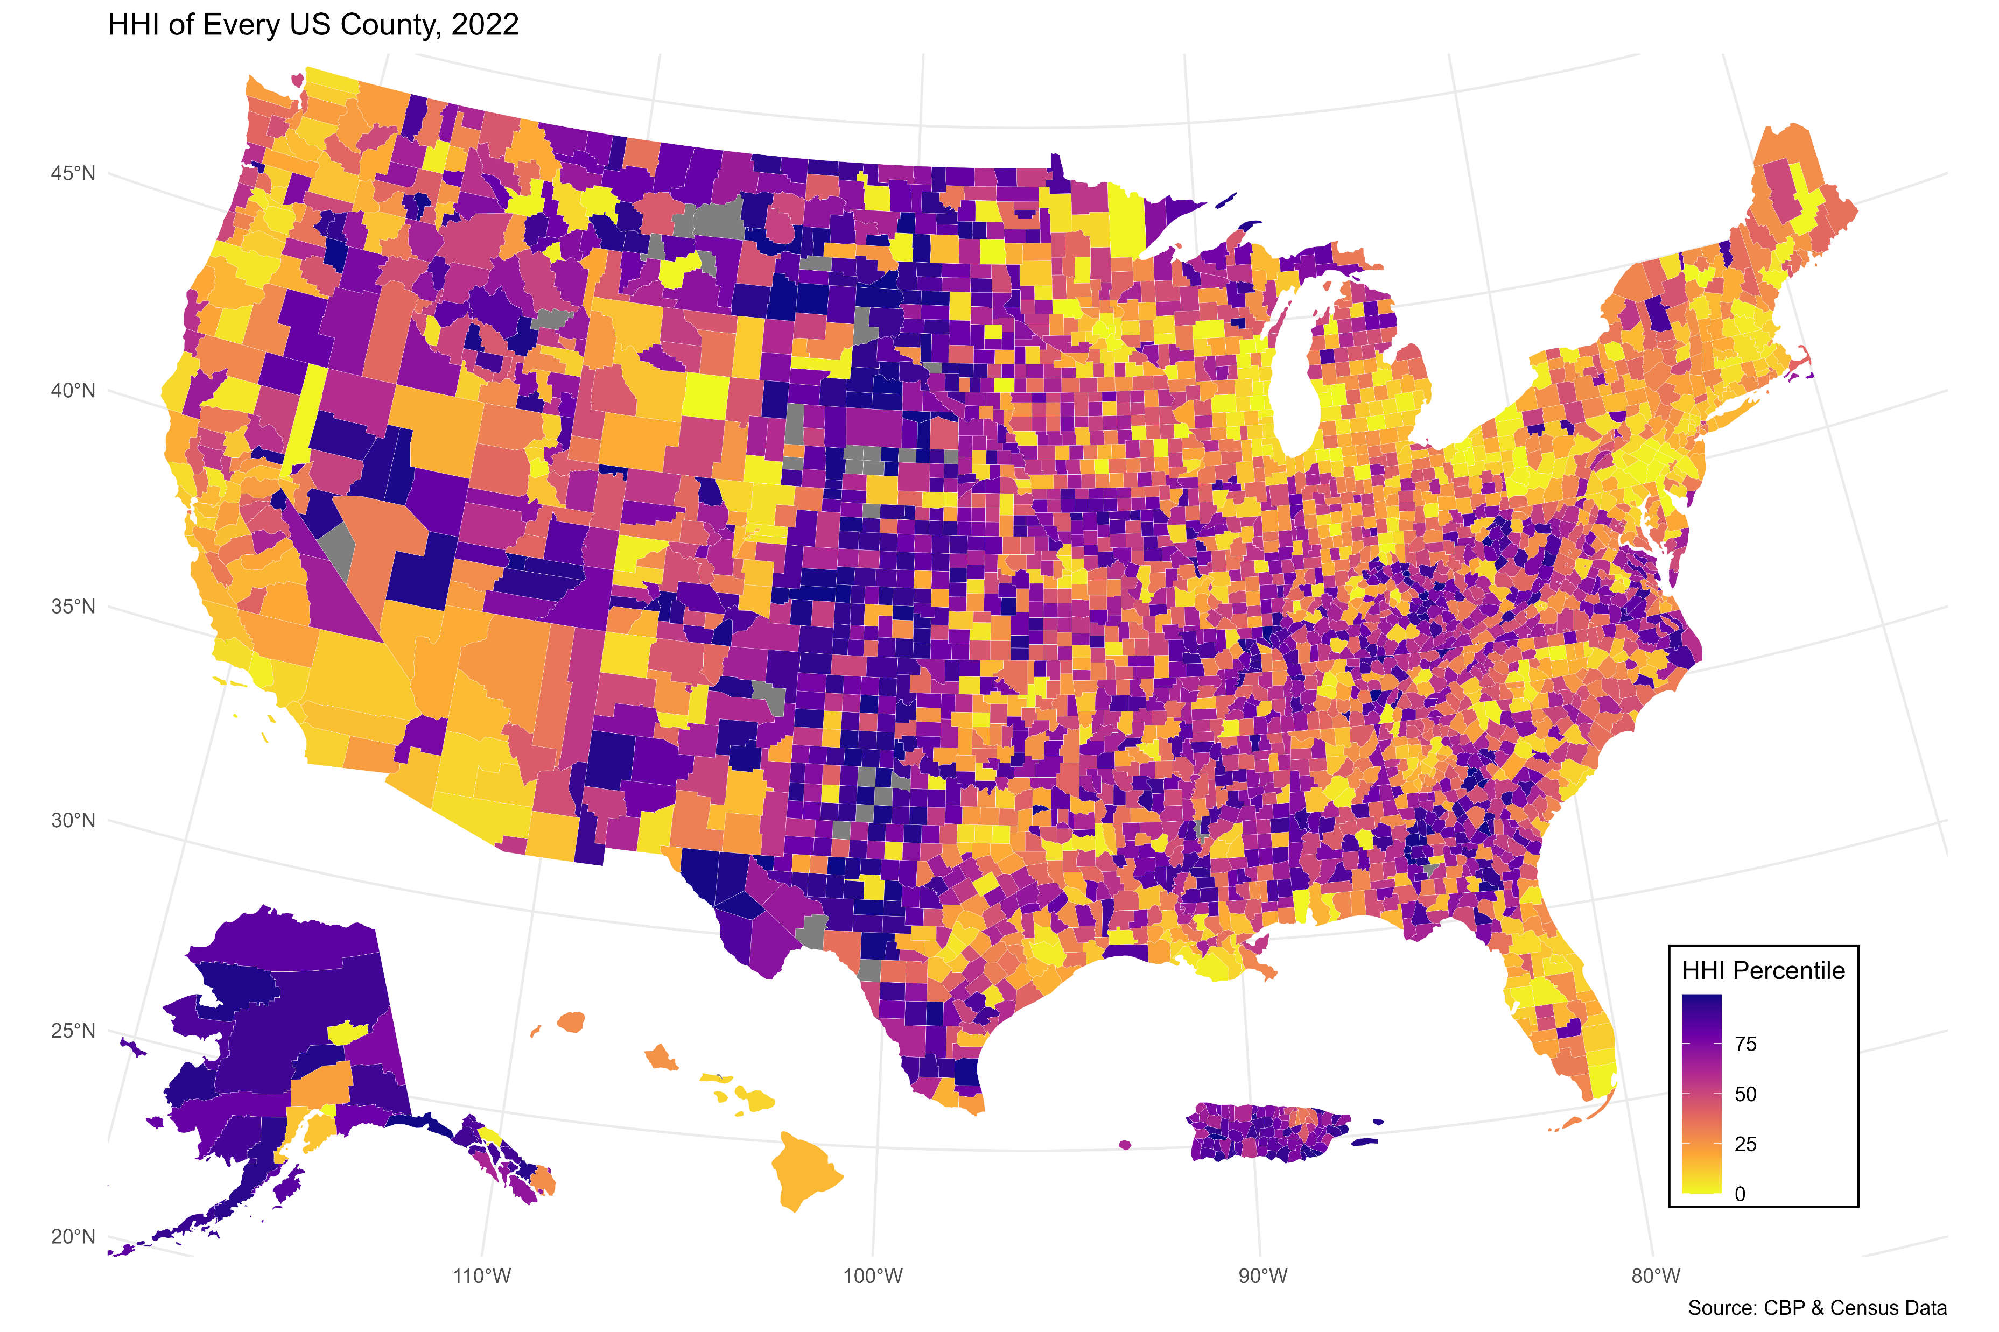
Why Business Diversity Matters
More resilient to shocks
Less diverse cities experience deeper contractions (De Soyres et al. 2024)
Supports employment growth
Through agglomeration and resilience (Frenken, Van Oort, and Verburg 2007)
Contributes to long-term development (Glaeser, Kerr, and Ponzetto 2010)
US Counties by HHI percentile. Darker colors = higher HHI
Spencer Ma
Skilled Immigration and Business Diversity
6
IAES BUPA Competition

Slide 7
Related Literature
Immigration and Entrepreneurship
Kerr and Kerr (2020); Beine, Peri, and Raux (2024); Azoulay et al. (2022); Peri, Shih, and Sparber (2015)
H-1B Visa
Mahajan et al. (2024); Mayda et al. (2023); Doren, Gelber, and Isen (2022); Kerr, Kerr, and Lincoln (2015)
Business Diversity (HHI)
de Soyres et al. (2024); Frenken, Van Oort, and Verburg (2007); Glaeser, Kerr, and Ponzetto (2010)
Contribution: First to relate the H-1B visa lottery to business diversity (HHI)
Spencer Ma
Skilled Immigration and Business Diversity
7
IAES BUPA Competition

Slide 8
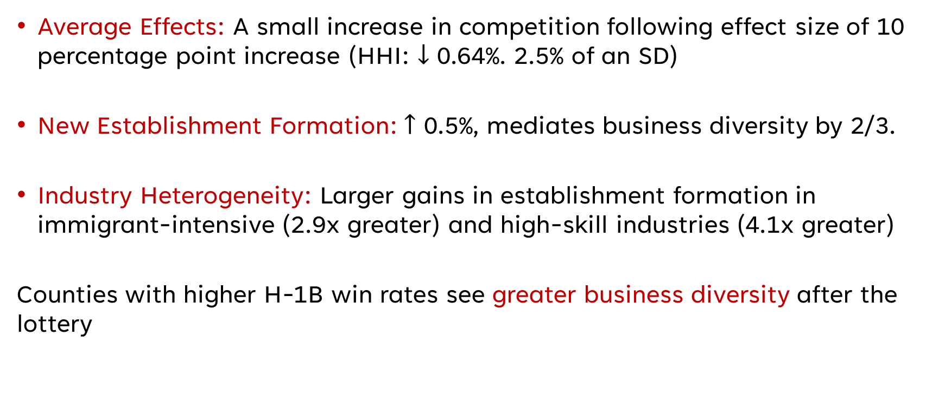
Preview of Findings
Average Effects: A small increase in competition following effect size of 10 percentage point increase (HHI: $↓$ 0.64%. 2.5% of an SD)
New Establishment Formation: $↑$ 0.5%, mediates business diversity by 2/3.
Industry Heterogeneity: Larger gains in establishment formation in immigrant-intensive (2.9x greater) and high-skill industries (4.1x greater)
Counties with higher H-1B win rates see greater business diversity after the lottery
Spencer Ma
Skilled Immigration and Business Diversity
8
IAES BUPA Competition

Slide 9
Outline
Constructing the CBP Panel, HHI, and H-1B Lottery Win Rate
Average Effects of the H-1B Lottery
Mechanisms
Skilled Heterogeneity
Robustness
Spencer Ma
Skilled Immigration and Business Diversity
9
IAES BUPA Competition

Slide 10
CBP Data Construction
Source: County Business patterns, 2012-2022
Industry Classification: 4-digit NAICS codes
Coverage: Excluded years prior to 2012 (data availability)
Data harmonization
Merged in 3 groups (2012-2013, 2014-2016, 2017-2022) due to formatting changes
Establishment Counts
Focus on all establishments by industry
Exclude “small business” counts (<500) since establishments are double-counted
CBP rarely suppresses “all establishments” column
Spencer Ma
Skilled Immigration and Business Diversity
10
IAES BUPA Competition

Slide 11
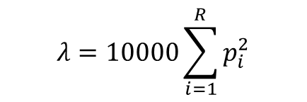
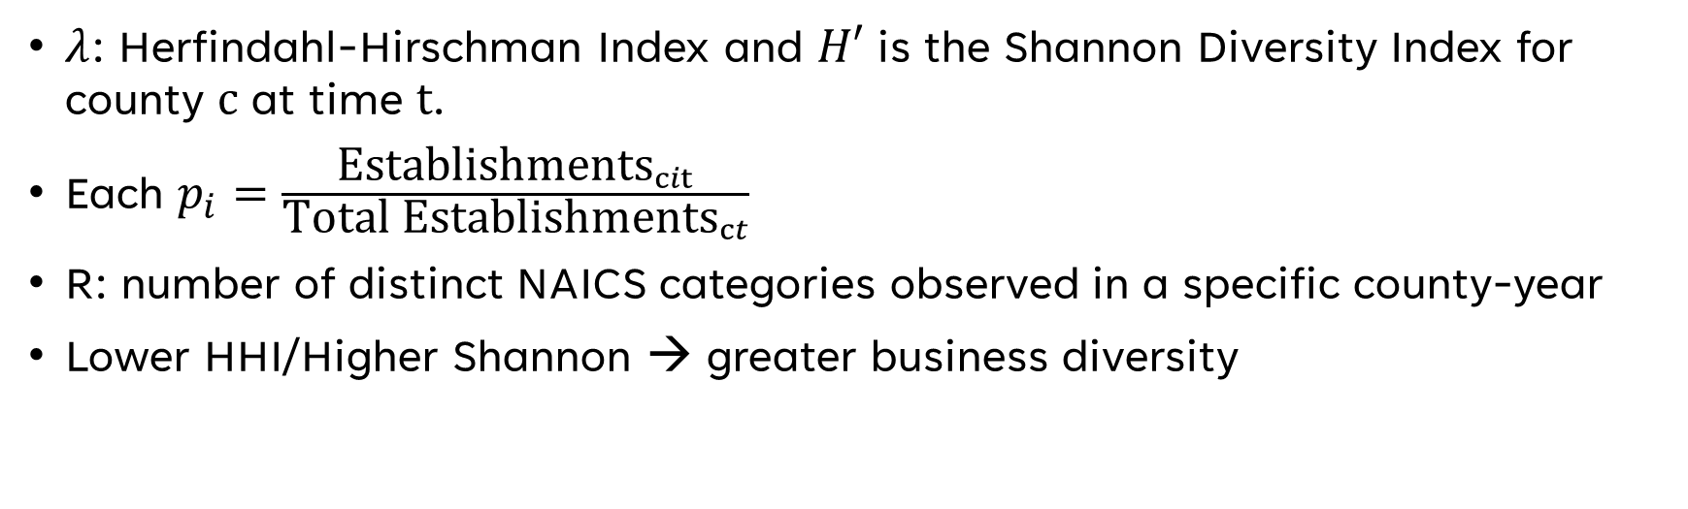
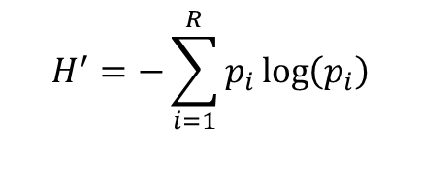
Diversity Indices
Herfindahl-Hirschman Index
Shannon Diversity Index (For Robustness)
$$λ=10000\sum_{i=1}^{R}{p_{i}^{2}}$$
$$H^{′}=−\sum_{i=1}^{R}{p_{i}}\log\left(p_{i}\right)$$
$λ$: Herfindahl-Hirschman Index and $H′$ is the Shannon Diversity Index for county $c$ at time $t$.
Each $p_{i}=\frac{{\text{Establishments}}_{cit}}{\text{Total} {\text{Establishments}}_{ct}}$
R: number of distinct NAICS categories observed in a specific county-year
Lower HHI/Higher Shannon → greater business diversity
Spencer Ma
Skilled Immigration and Business Diversity
11
IAES BUPA Competition

Slide 12
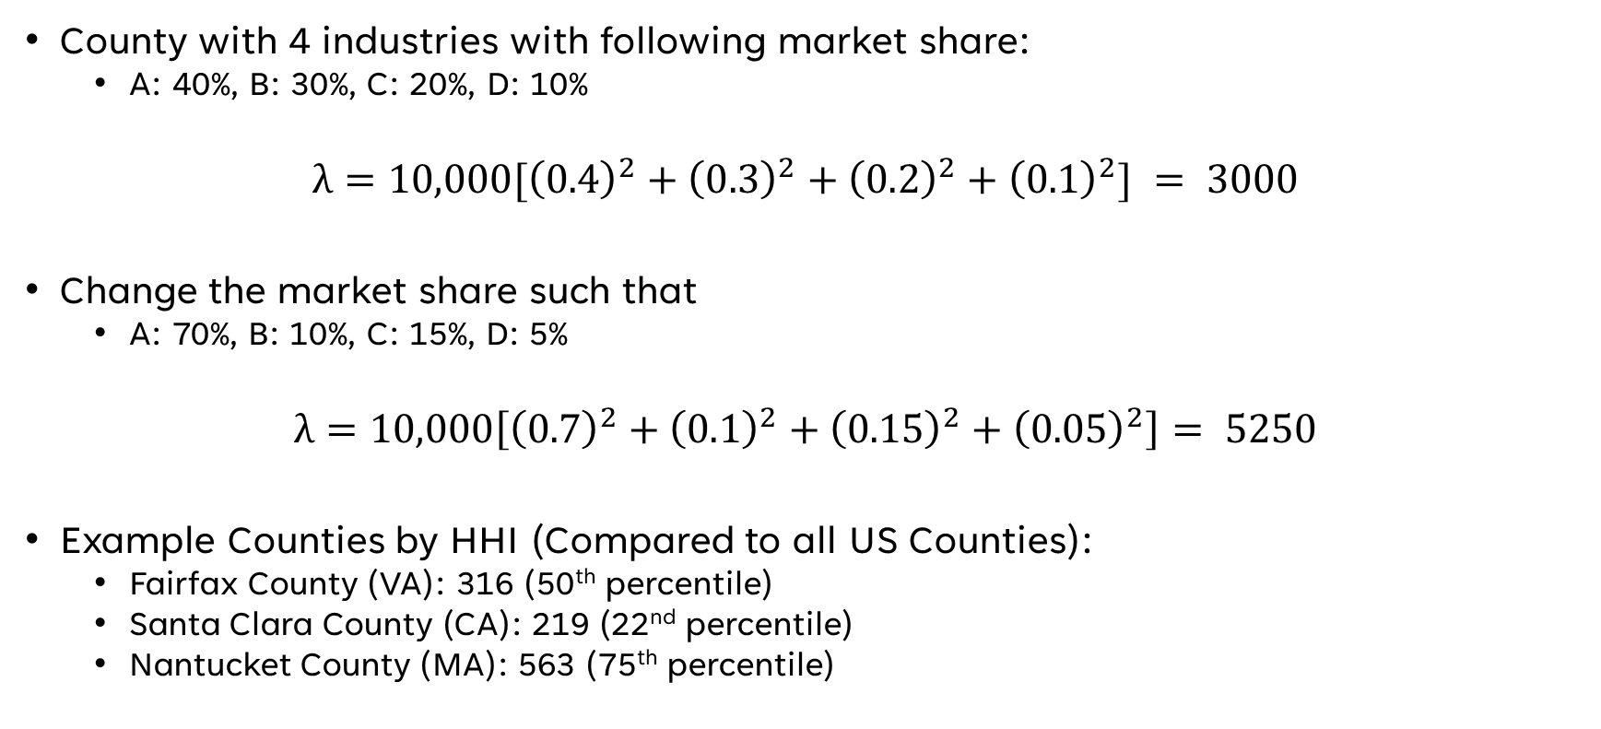
HHI Example
County with 4 industries with following market share:
A: 40%, B: 30%, C: 20%, D: 10%
$$λ={10,000[\left(0.4\right)}^{2}+{\left(0.3\right)}^{2}+{\left(0.2\right)}^{2}+{\left(0.1\right)}^{2}] = 3000$$
Change the market share such that
A: 70%, B: 10%, C: 15%, D: 5%
$$λ=10,000\left[{\left(0.7\right)}^{2}+{\left(0.1\right)}^{2}+{\left(0.15\right)}^{2}+{\left(0.05\right)}^{2}\right]= 5250$$
Example Counties by HHI (Compared to all US Counties):
Fairfax County (VA): 316 (50th percentile)
Santa Clara County (CA): 219 (22nd percentile)
Nantucket County (MA): 563 (75th percentile)
Spencer Ma
Skilled Immigration and Business Diversity
12
IAES BUPA Competition

Slide 13
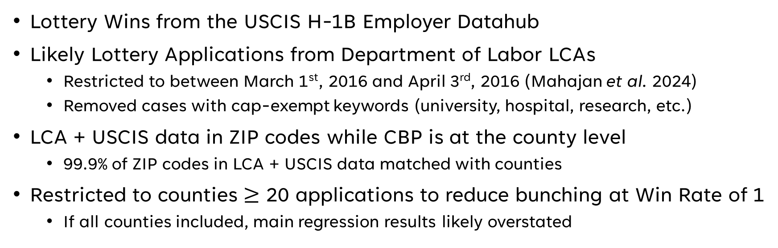
Constructing the Lottery Win Rate
$${\text{Win} \text{Rate}}_{ct}=\frac{{\text{Lottery} \text{Wins}}_{ct}}{{\text{Likely} \text{Lottery} \text{Applications}}_{ct}}$$
Lottery Wins from the USCIS H-1B Employer Datahub
Likely Lottery Applications from Department of Labor LCAs
Restricted to between March 1st, 2016 and April 3rd, 2016 (Mahajan et al. 2024)
Removed cases with cap-exempt keywords (university, hospital, research, etc.)
LCA + USCIS data in ZIP codes while CBP is at the county level
99.9% of ZIP codes in LCA + USCIS data matched with counties
Restricted to counties $≥$ 20 applications to reduce bunching at Win Rate of 1
If all counties included, main regression results likely overstated
Spencer Ma
Skilled Immigration and Business Diversity
13
IAES BUPA Competition

Slide 14
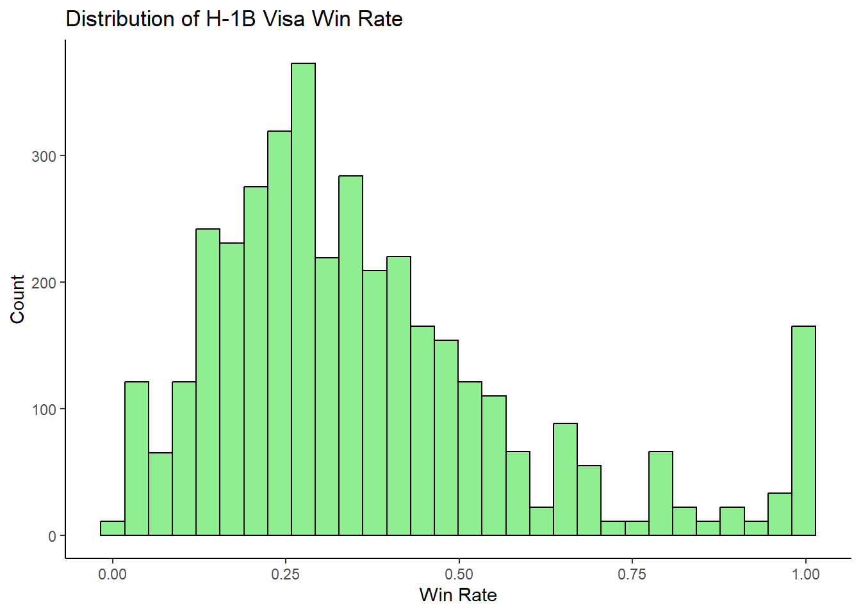
Summary Statistics
Figure: Distribution of H-1B Visa Win Rate
Table: Summary Statistics for HHI and Win Rate
 | HHI | Lottery Win Rate
Minimum | 142.9 | 0.00285
1st Quartile | 174.9 | 0.20826
Median | 187.3 | 0.31707
Mean | 209.0 | 0.36785
3rd Quartile | 205.9 | 0.46512
Maximum | 2551.0 | 1.00000
Spencer Ma
Skilled Immigration and Business Diversity
14
IAES BUPA Competition

Slide 15
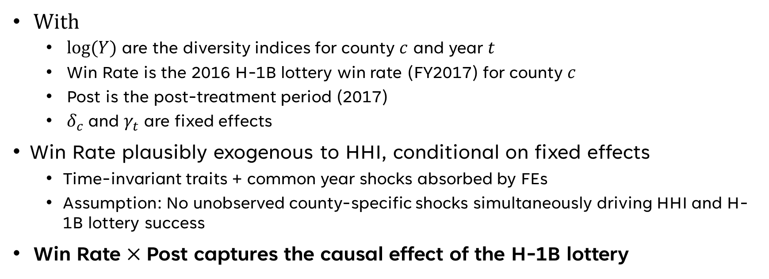
Empirical Specification
$${\log\left(Y\right)}_{ct}=α\text{ + }β({\text{Win} \text{Rate}}_{c}×{\text{Post}}_{t}\text{) + }δ_{c}+γ_{t}+ ϵ_{ct}$$
With
$\log{(Y)}$ are the diversity indices for county $c$ and year $t$
Win Rate is the 2016 H-1B lottery win rate (FY2017) for county $c$
Post is the post-treatment period (2017)
$δ_{c} \text{and} γ_{t}$ are fixed effects
Win Rate plausibly exogenous to HHI, conditional on fixed effects
Time-invariant traits + common year shocks absorbed by FEs
Assumption: No unobserved county-specific shocks simultaneously driving HHI and H-1B lottery success
$\text{Win} \text{Rate}×\text{Post}$ captures the causal effect of the H-1B lottery
Spencer Ma
Skilled Immigration and Business Diversity
15
IAES BUPA Competition

Slide 16
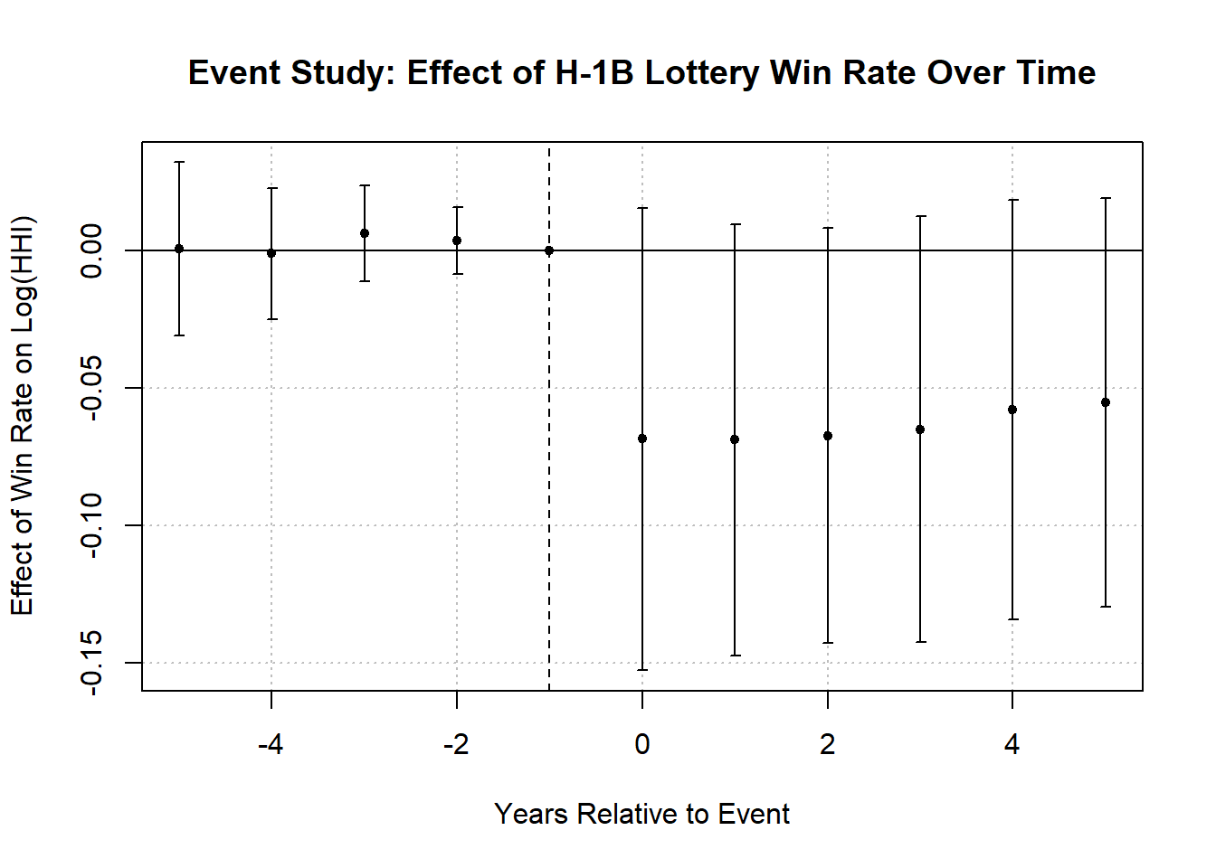
Empirical Specification
Event Study (2016 H-1B Lottery for FY2017)
Parallel Trends Assumption
No significance for pre-treatment years
Clear Post-Treatment Divergence
Wald Test cannot reject joint significance (p = 0.36)
SUTVA
Counties are arbitrary geographic units
Results remain significant (p = 0.04) when restricting to local industries
Spencer Ma
Skilled Immigration and Business Diversity
16
IAES BUPA Competition

Slide 17
Outline
Constructing the HHI and H-1B Lottery Win Rate
Average Effects of the H-1B Lottery
Mechanisms
Skilled Heterogeneity
Robustness
Spencer Ma
Skilled Immigration and Business Diversity
17
IAES BUPA Competition

Slide 18
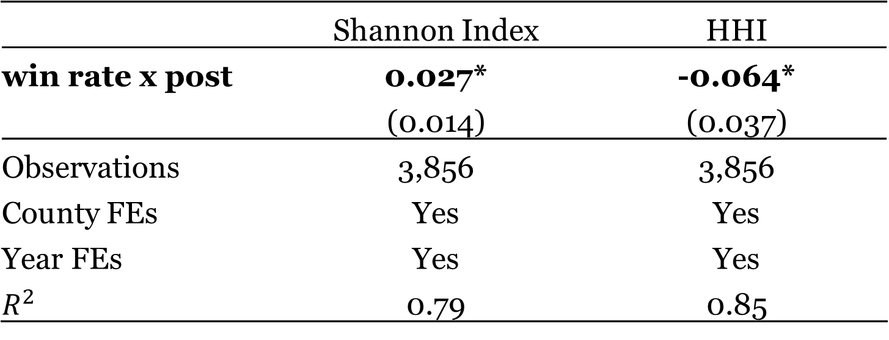
Results
Table: Effect of H-1B Lottery Success on Business Diversity (HHI and Shannon Index)
 | Shannon Index | HHI
win rate x post | 0.027* | -0.064*
 | (0.014) | (0.037)
Observations | 3,856 | 3,856
County FEs | Yes | Yes
Year FEs | Yes | Yes
$$R^{2}$$ | 0.79 | 0.85
Note: * p< 0.1; ** p<0.05; *** p<0.01. Standard errors are clustered by County. Results are interpreted with a 100-percentage-point increase
Spencer Ma
Skilled Immigration and Business Diversity
18
IAES BUPA Competition

Slide 19
Outline
Constructing the HHI and H-1B Lottery Win Rate
Average Effects of the H-1B Lottery
Mechanisms
Skilled Heterogeneity
Robustness
Spencer Ma
Skilled Immigration and Business Diversity
19
IAES BUPA Competition

Slide 20
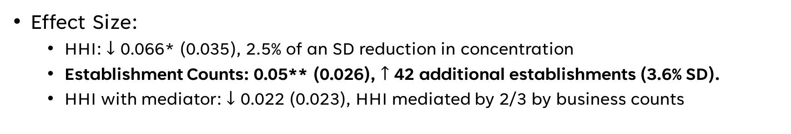
Mechanisms: New Business Formation
New Business Formation
H-1B Lottery
Business Diversity (HHI)
Effect Size:
HHI: $↓$ 0.066* (0.035), 2.5% of an SD reduction in concentration
Establishment Counts: 0.05** (0.026), $↑$ 42 additional establishments (3.6% SD).
HHI with mediator: $↓$ 0.022 (0.023), HHI mediated by 2/3 by business counts
Spencer Ma
Skilled Immigration and Business Diversity
20
IAES BUPA Competition

Slide 21
Outline
Constructing the HHI and H-1B Lottery Win Rate
Average Effects of the H-1B Lottery
Mechanisms
Skilled Heterogeneity
Robustness
Spencer Ma
Skilled Immigration and Business Diversity
21
IAES BUPA Competition

Slide 22
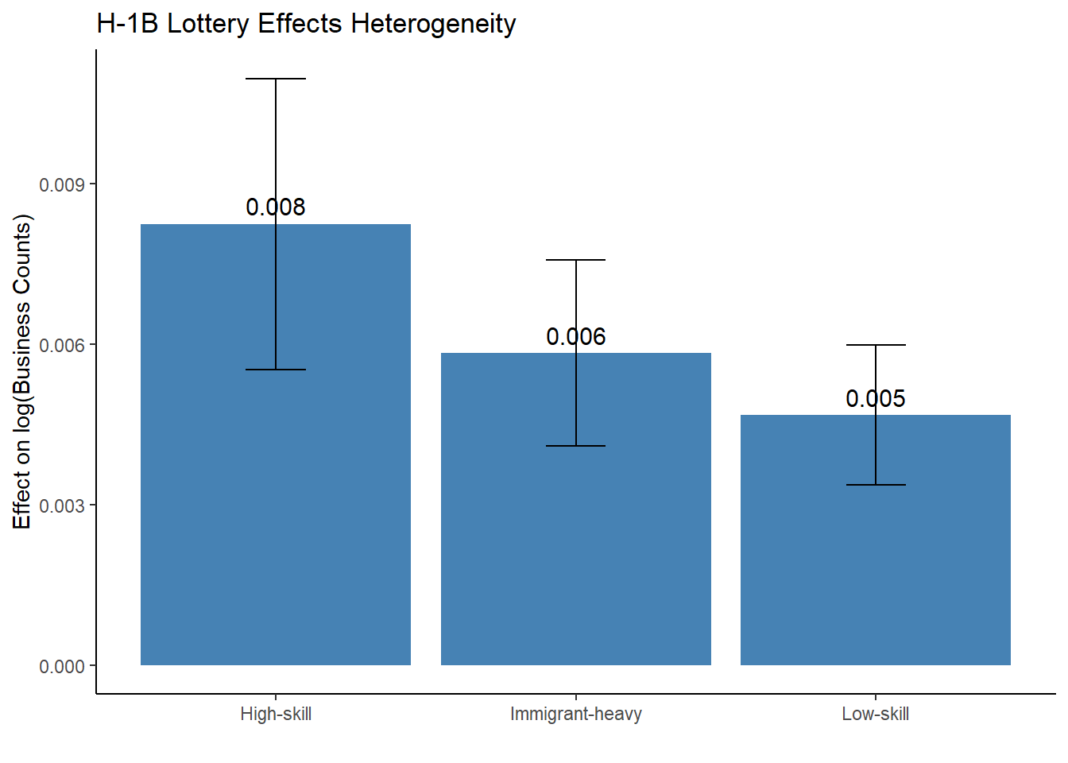
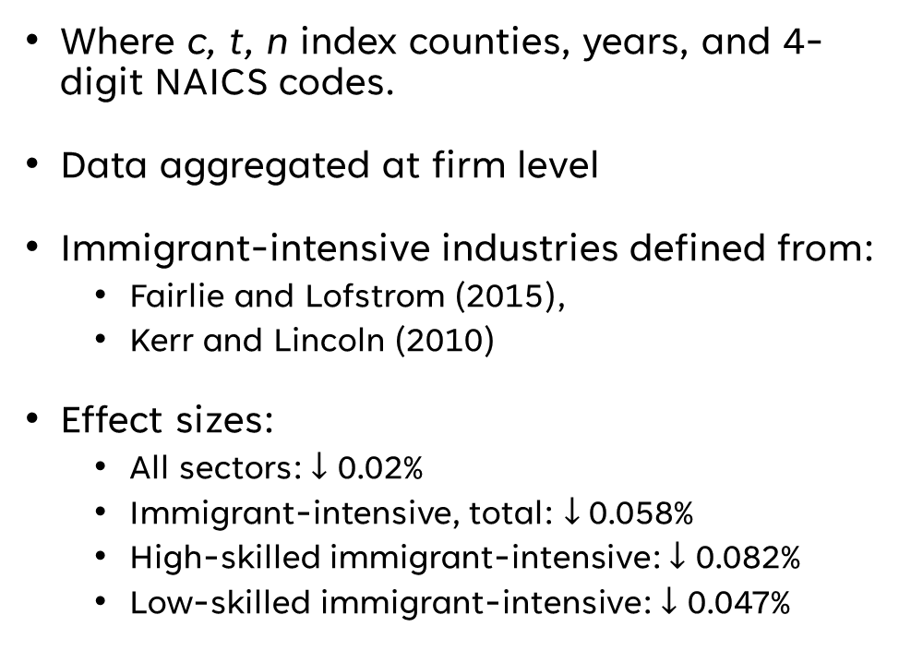
Immigrant Heterogeneity
$${\log\left(\text{Estab}\text{. }\text{Counts}\right)}_{ctn} =α\text{ + }β({\text{Win} \text{Rate}}_{c}×{\text{Post}}_{t}\text{) + }δ_{c}+γ_{t}+ρ_{n}+ ϵ_{ctn}$$
Where c, t, n index counties, years, and 4-digit NAICS codes.
Data aggregated at firm level
Immigrant-intensive industries defined from:
Fairlie and Lofstrom (2015),
Kerr and Lincoln (2010)
Effect sizes:
All sectors: $↓$ 0.02%
Immigrant-intensive, total: $↓$0.058%
High-skilled immigrant-intensive: $↓$ 0.082%
Low-skilled immigrant-intensive: $↓$ 0.047%
Spencer Ma
Skilled Immigration and Business Diversity
22
IAES BUPA Competition

Slide 23
Outline
Constructing the HHI and H-1B Lottery Win Rate
Average Effects of the H-1B Lottery
Mechanisms
Skilled Heterogeneity
Robustness
Spencer Ma
Skilled Immigration and Business Diversity
23
IAES BUPA Competition

Slide 24
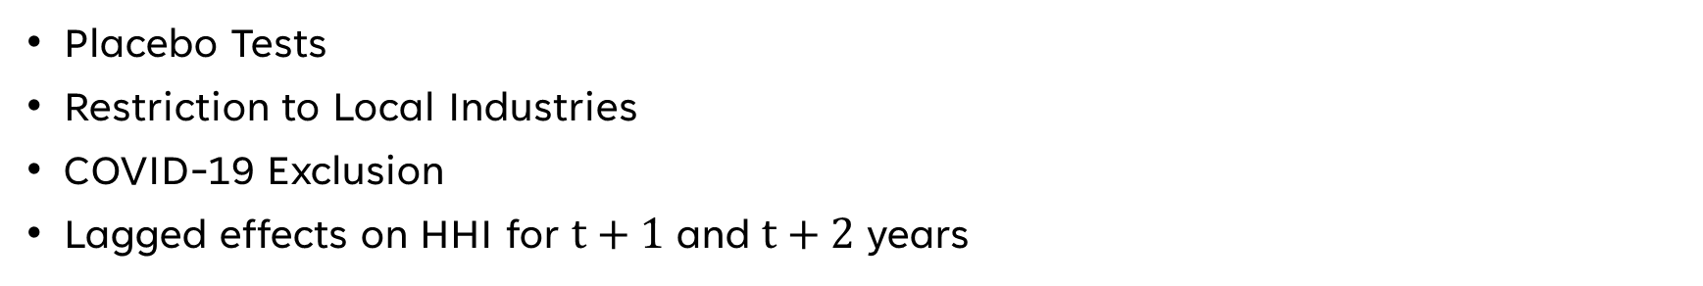
Robustness
Placebo Tests
Restriction to Local Industries
COVID-19 Exclusion
Lagged effects on HHI for $t+1$ and $t+2$ years
Specification | Coefficient | Std. Error | Significance
Placebo (FY2014) | -0.04 | 0.026
Placebo (FY2015) | -0.049 | 0.028 | *
Placebo (FY2016) | -0.057 | 0.031 | *
Excl. COVID Years | -0.07 | 0.039 | *
Restrict to Local | -0.004 | 0.001 | **
Restrict to Tradable | -0.004 | 0.004
Lags (1 and 2 year) | -0.032 | 0.018 | *
Spencer Ma
Skilled Immigration and Business Diversity
24
IAES BUPA Competition

Slide 25
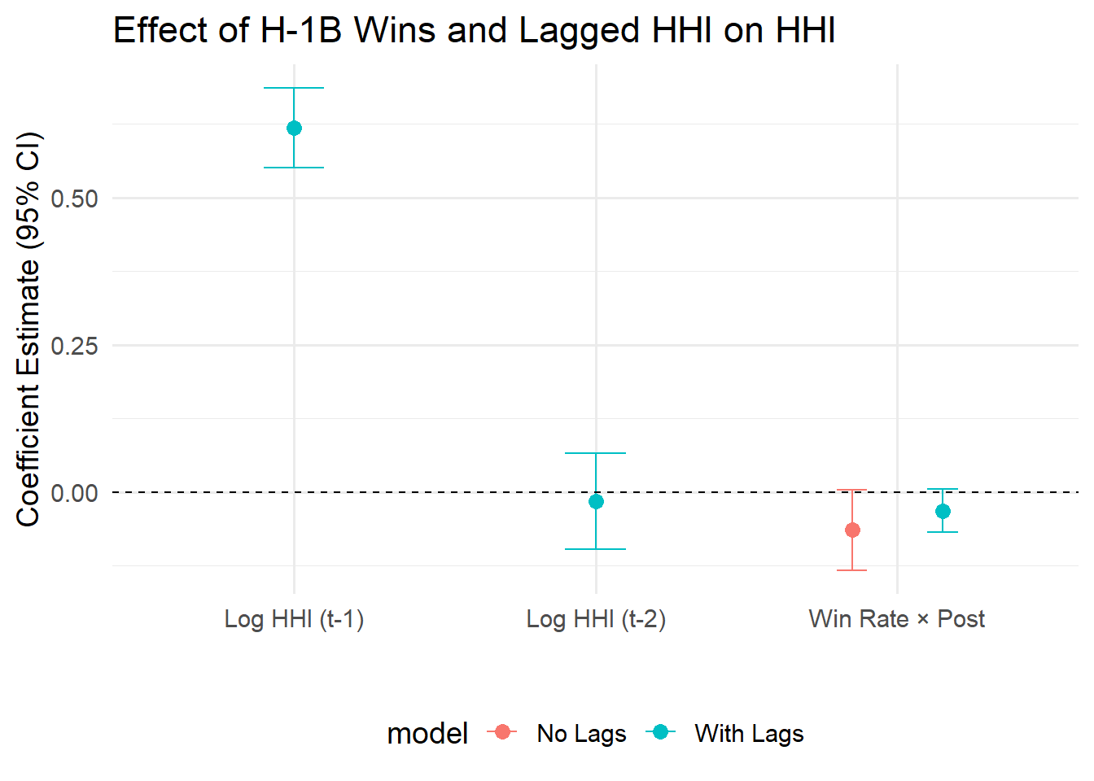
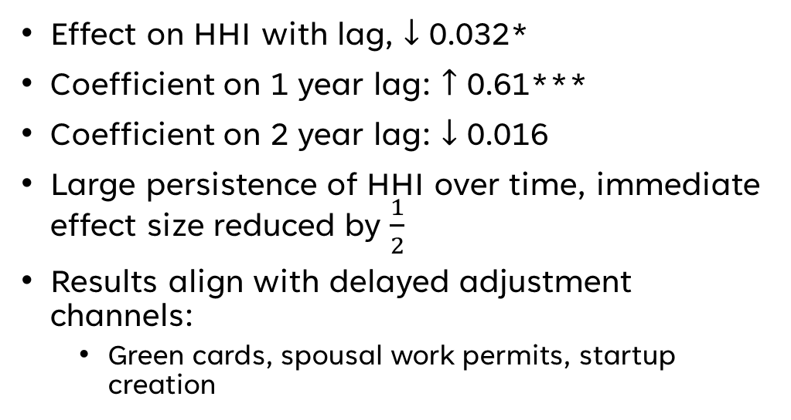
Robustness: 1 Year and 2 Year Lagged HHI
Effect on HHI with lag, $↓$ 0.032*
Coefficient on 1 year lag: $↑$ 0.61***
Coefficient on 2 year lag: $↓$ 0.016
Large persistence of HHI over time, immediate effect size reduced by $\frac{1}{2}$
Results align with delayed adjustment channels:
Green cards, spousal work permits, startup creation
Spencer Ma
Skilled Immigration and Business Diversity
25
IAES BUPA Competition

Slide 26
Summary
The H-1B lottery increases business diversity at the county-level
The increase in business diversity is largely driven by new business formation
Effect of new business formation is greater in immigrant-intensive industries
Spencer Ma
Skilled Immigration and Business Diversity
26
IAES BUPA Competition

Slide 27
Policy Implications
Greater business diversity → more resilient local economies
Hiring through H-1B visa has positive spillovers
$100,000 H-1B visa fee likely to decrease business diversity at county-level
Policy takeaway: expanding skilled immigration strengthens local economies
Spencer Ma
Skilled Immigration and Business Diversity
27
IAES BUPA Competition

Slide 28
Thank you!
Spencer Ma
Skilled Immigration and Business Diversity
28
IAES BUPA Competition

Slide 29
Mediation: New Business Formation
Three regressions estimated:
1) Original DiD estimation
$${\log\left(\text{HHI}\right)}_{ct}=α\text{ + }β({\text{Win} \text{Rate}}_{c}×{\text{Post}}_{t}\text{) + }δ_{c}+γ_{t}+ ϵ_{ct}$$
2) DiD estimation on business counts
$${\log\left(\text{Business} \text{Counts}\right)}_{ct}=α\text{ + }β({\text{Win} \text{Rate}}_{c}×{\text{Post}}_{t}\text{) + }δ_{c}+γ_{t}+ ϵ_{ct}$$
3) Original DiD with mediation
$${\log\left(\text{HHI}\right)}_{ct}=α\text{ + }β({\text{Win} \text{Rate}}_{c}×{\text{Post}}_{t}\text{)}\text{ +}{θlog\left(\text{Business} \text{Counts}\right)}_{ct}\text{+ }δ_{c}+γ_{t}+ ϵ_{ct}$$
Spencer Ma
Skilled Immigration and Business Diversity
29
IAES BUPA Competition

Slide 30
Mediation: New Business Formation
Table: Mechanism Analysis: Business Formation and Market Concentration
 | HHI | Business Counts | HHI w/ Mediator
Win Rate × Post | -0.066* | 0.050** | -0.022
 | (0.035) | (0.026) | (0.023)
log(Business Counts) |  |  | -0.865*** (0.151)
Observations | 3,823 | 3,823 | 3,823
County Fixed Effects | Yes | Yes | Yes
Year Fixed Effects | Yes | Yes | Yes
Spencer Ma
Skilled Immigration and Business Diversity
30
IAES BUPA Competition

Slide 31
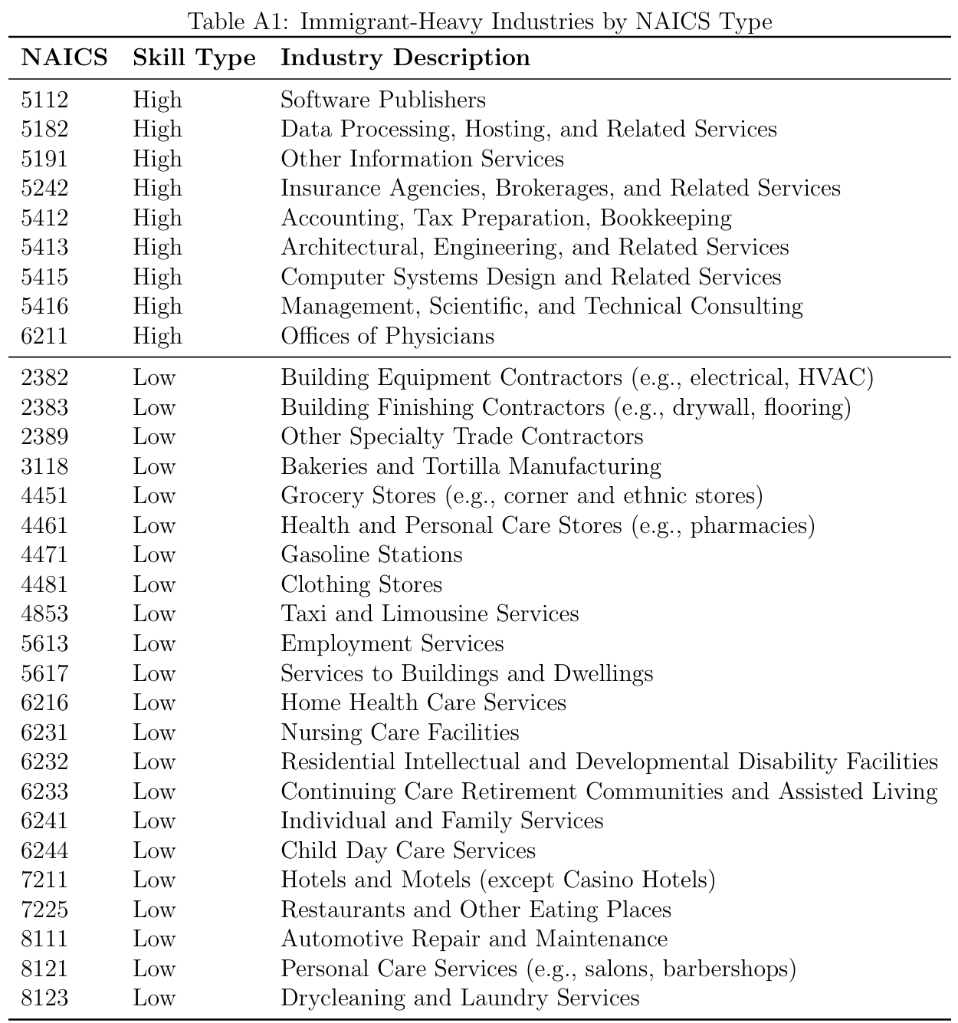
Spencer Ma
Skilled Immigration and Business Diversity
31
IAES BUPA Competition

Slide 32
Immigrant Heterogeneity
Table: Effect of H-1B Lottery Success on Business Counts in Immigrant-Intensive Industries
 | All Sectors | Immigrant-Intensive | High-Skill | Low-Skill
Win rate × Post | 0.0022*** | 0.0058*** | 0.0082*** | 0.0047**
 | (0.0008) | (0.0017) | (0.0027) | (0.0013)
Observations | 764,950 | 113,128 | 32,332 | 80,796
County Fixed Effects | Yes | Yes | Yes | Yes
Year Fixed Effects | Yes | Yes | Yes | Yes
Industry Fixed Effects | Yes | Yes | Yes | Yes
Spencer Ma
Skilled Immigration and Business Diversity
32
IAES BUPA Competition

Slide 33
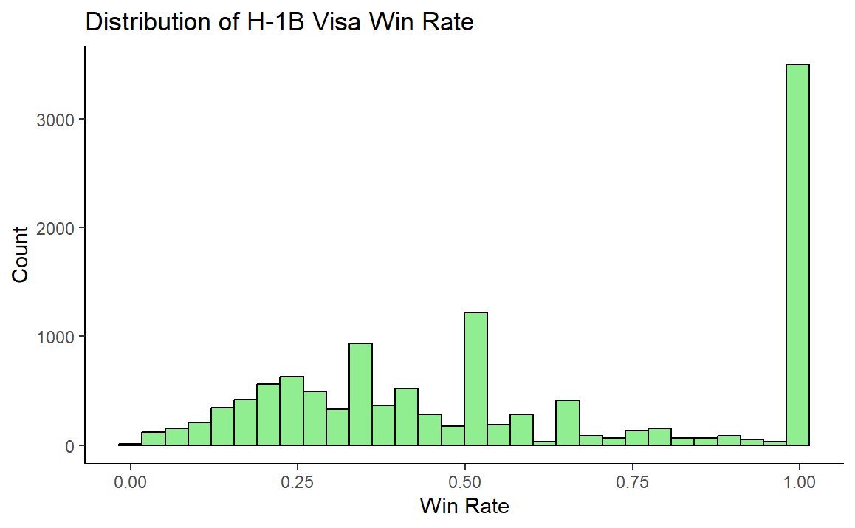
Unrestricted Win Rate
Spencer Ma
Skilled Immigration and Business Diversity
33
IAES BUPA Competition

Slide 34
Beamer: CambridgeUS Template
Spencer Ma
Skilled Immigration and Business Diversity
34
IAES BUPA Competition

