Slide 1


Medicaid Expansion and Crime Outcomes
IAES BUPA Presentation | 11th October 2025
Abizer Khumusi

Slide 2
Policy Background
US Federal Government passed the Affordable Care Act (ACA) in 2010 which was primarily to address the high costs associated with healthcare:
In participating states, Medicaid eligibility is expanded to all individuals with income up to 138% of poverty line INCLUDING adults without dependent children
Participating states had substantial increases in coverage:
~11pp in 2014, ~16pp in 2015 [Frean et al., 2017; Miller and Wherry 2016, 2017]
For young adults with income <138% of poverty line: coverage increased by ~11pp [McMorrow et al., 2015]
Introduction
Literature Review
Methodology
Data
Results & Checks
Conclusion

Slide 3
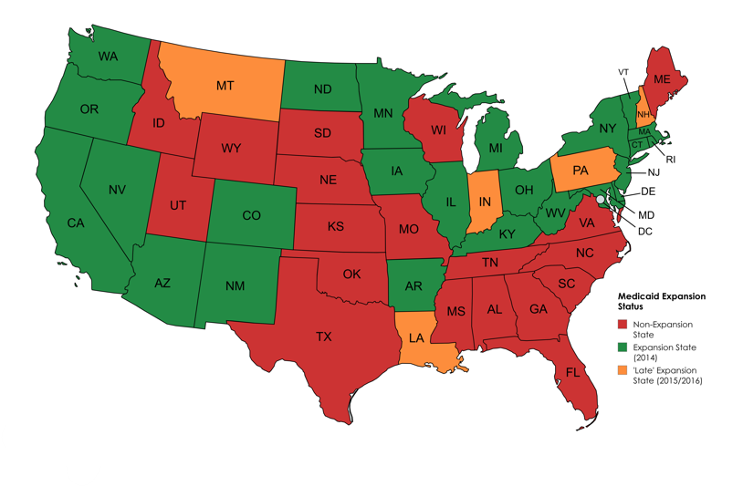
The ability of states to choose to participate/opt-out of Medicaid expansion…
… has created variation across states in policy/date of implementation
This variation can be used to see if the Medicaid expansion has an impact on various outcomes.
Note: AL, HI excluded from map. Several ‘non-expansion states’ proceeded to expand after 2016, but are considered non-expansion for our analysis: VA (1/1/2019), ME (10/1/2019), ID (1/1/2020), UT (1/1/2020), NE (1/10/2020), OK (1/7/2021), MO (1/10/2021), SD (1/7/2023), NC (12/1/2023).
Introduction
Literature Review
Methodology
Data
Results & Checks
Conclusion

Slide 4
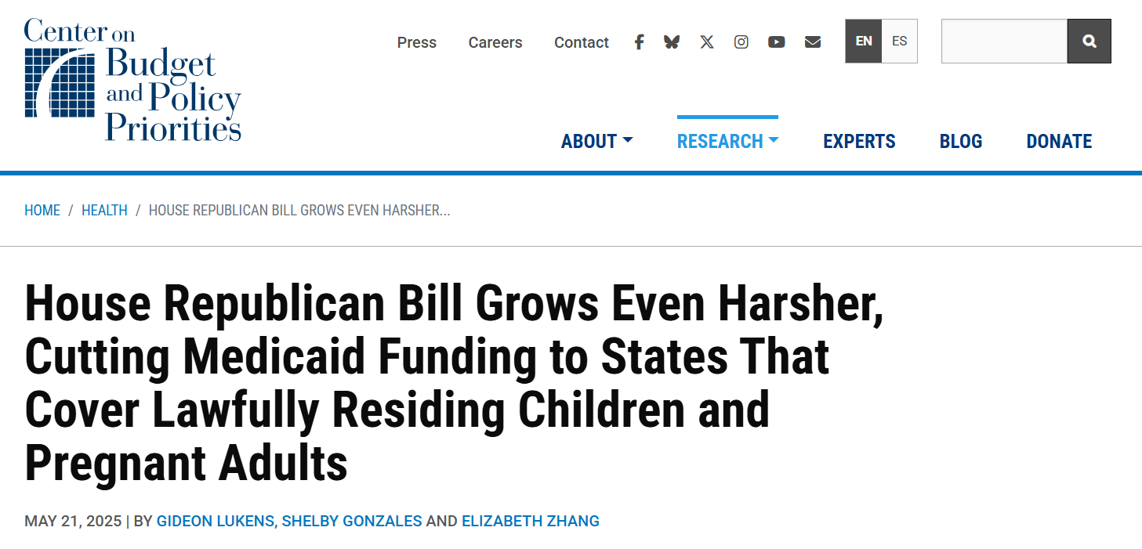
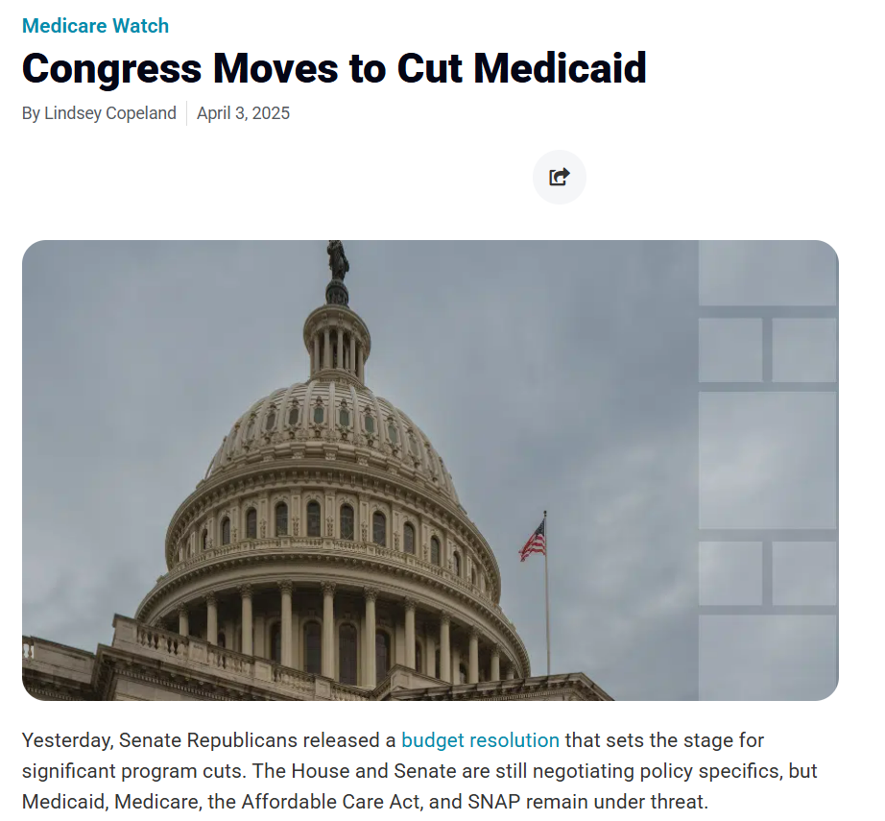
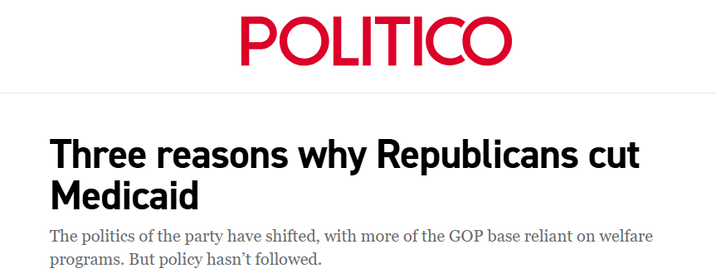
Amidst moves to cut Medicaid funding…
… there is a need to robustly quantify its social and economic spillovers.
Introduction
Literature Review
Methodology
Data
Results & Checks
Conclusion

Slide 5
There has been extensive work done in the literature on evaluating these spillovers to better quantify the benefits of Medicaid expansion:
However, there is limited robust literature specifically on the effect of Medicaid expansion on crime. Our paper aims to fill this gap.
The effects of Medicaid expansion on labour market outcomes [Peng et al., 2019] | Uses data from Quarterly Census of Employment (QCEW) to see how Medicaid expansion affects employment levels.
The impact of the ACA Medicaid Expansion on SNAP participation [Burney et al., 2021] | Uses data from Consumer Expenditure Survey to show that Medicaid expansion leads to a 17.1% increase in probability of SNAP participation.
How does expansion of public health insurance affect risk pools and premiums in the market for private health insurance? [Sen and DeLeire, 2018] | Uses data from Health Insurance Exchange Public Use Files to show that marketplace premiums were 11% lower in expansion states.
The Effect of the Patient Protection and Affordable Care Act Medicaid Expansions on Financial Wellbeing [Hu et al., 2018] | Finds that Medicaid expansion leads to reduction in amount of unpaid bills and debt amongst those residing in zip codes with higher share of lower-income individuals
Introduction
Literature Review
Methodology
Data
Results & Checks
Conclusion

Slide 6
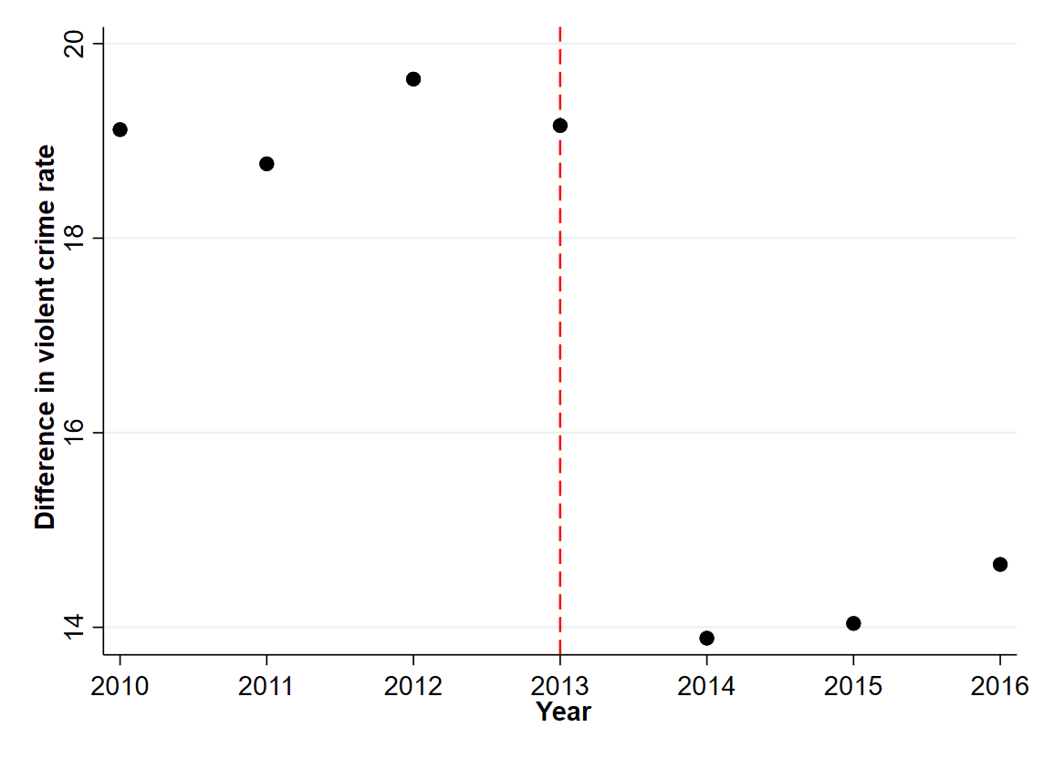
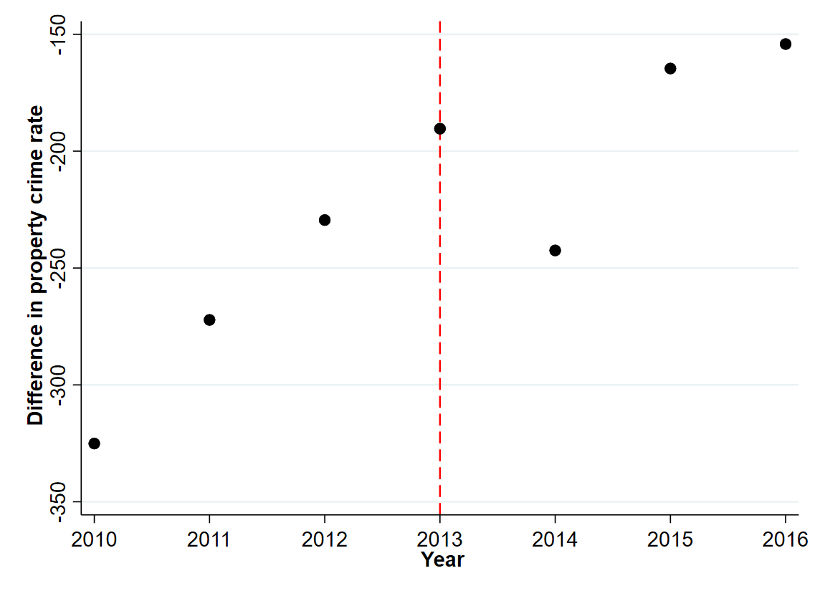
A naive scatterplot of differences in crime rates [crimes per 100k popn] across expansion and non-expansion states…
… shows some permanent effect on violent crime, and some transitory effect on property crime following Medicaid expansion. We want to investigate if this effect is statistically significant.
Note: 2015/2016 expansion states [AK, MT, IN, LA, PA] dropped from plots so as to not conflate trends
Introduction
Literature Review
Methodology
Data
Results & Checks
Conclusion

Slide 7
There does exist some literature discussing Medicaid expansion and effects on crime and recidivism…
… but they use ‘naive’ DiD setups which exclude key variables and disregard spatial heterogeneity. Our paper aims to fill that gap.
The effect of health insurance on crime: Evidence from the Affordable Care Act Medicaid expansion [He and Barkowski, 2020] | Paper uses a DiD with state-fixed effects to show that ACA medicaid expansion reduced burglary by 3.8%, vehicle theft by 10.4%, homicide by 8.1%, robbery by 6.3%, and assault by 2.9% in expansion states. Reduction in value of crime by $10billion/year.
Access to Healthcare and Criminal Behavior [Vogler, 2020] | Used a DiD with state-fixed effects to show that the expansion results in a 5.3% reduction in annual reported violent crime, with an annual cost saving of roughly $4billion.
The Effect of Public Health Insurance on Criminal Recidivism [Aslim et al., 2021] | Shows that Medicaid expansion sharply raises access to Substance Use Disorder (SUD) treatment as well as reduces recidivism by 15-16%.
Introduction
Literature Review
Methodology
Data
Results & Checks
Conclusion

Slide 8
Methodology [1]: Conceptualising a refined county-pair model
Introduction
Literature Review
Methodology
Data
Results & Checks
Conclusion

Slide 9
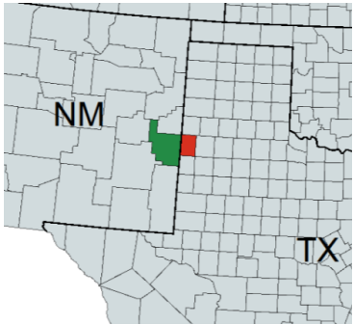
Methodology [1]: Conceptualising a refined county-pair model
We expect a given county-pair to be quite homogenous since they are neighbours. Yet, they straddle the state border with different Medicaid expansion status.
Therefore, one county can be used as a “control” for the other.
Introduction
Literature Review
Methodology
Data
Results & Checks
Conclusion

Slide 10
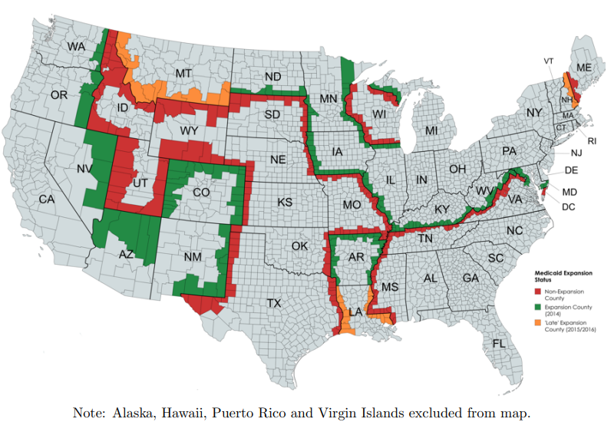
Methodology [1]: Conceptualising a refined county-pair model
We take all such
non-expansion/expansion pairs
as well as
non-expansion/late-expansion pairs to form our new data-set
We refrain from using late-expansion/expansion pairs since staggered adoption could produce biased estimators when dealing with multiway fixed-effects
[Goodman-Bacon, 2021; Wing et al., 2024]
Introduction
Literature Review
Methodology
Data
Results & Checks
Conclusion

Slide 11
Methodology [1]: Formalising the contiguous-border county-pair model
dExpand_{c, p, t} is out treatment variable → β represents our intent to treat estimator ρ_{c} → county fixed-effects τ_{t} → time fixed-effects Ψ_{p} → county-pair fixed-effects
Γ_{p, t} → county-pair time-variant fixed-effects
[In specification with Γ_{p, t} term, we exclude both Ψ_{p} and τ_{t} since they are perfectly correlated]
Introduction
Literature Review
Methodology
Data
Results & Checks
Conclusion

Slide 12
Methodology [2]: Inclusion of Richer Controls
Φ: vector of county-level demographics, economic variables which include:
% male, % black, white, Hispanic, % completed Bachelor’s degree
% 0-18 y/o, 19-59 y/o, >=60 y/o
Median income, unemployment rate, % <138% FPL
Λ: vector of state-level economic/expenditure variables which include:
GINI coefficient
Education expenditure, welfare expenditure
Police expenditure, legal expenditure [used to proxy for law enforcement intensity]
PVI_{s, t}: political control variable [serves as proxy of magnitude of underlying political sentiment & also captures legislative capacity of a given party]
Introduction
Literature Review
Methodology
Data
Results & Checks
Conclusion

Slide 13
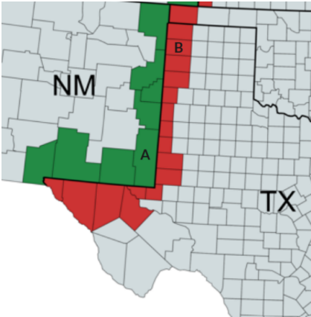
Methodology [3]: Further Specifications
Each county will appear in the data-set as many times as it has neighbouring cross-border counties.
On the example on the left, the highlighted county in New Mexico will appear in the data-set 6 times.
Introduction
Literature Review
Methodology
Data
Results & Checks
Conclusion

Slide 14
Methodology [3]: Further Specifications
This however, does create correlation across county pairs.
To resolve this, we multi-way cluster standard-errors by (Cameron & Miller, 2015):
State (to account for spatial correlation)
County-pair (to account for temporal correlation)
County (to account for correlations across pairs with repeated counties)
Introduction
Literature Review
Methodology
Data
Results & Checks
Conclusion

Slide 15
Summarising data-sets used [1]
Data-Set | Description | Comment (if applicable):
FBI Uniform Crime Reports (UCR) | State-level crime data for 2010-2016 constructed by the FBI. Broken down into property/violent crimes and into further subcategories. | The way that the sub-category “Rape” and “Arson” is calculated changes in 2013, making the numbers incomparable over different years.
 | County-level crime data for 2010-2014, 2016 obtained from Inter-university Consortium for Political and Social Research. | NA
American Community Survey Public Use Microdata | Pooled OLS data set constructed by the US Census Bureau. Contains housing, economic and demographic data. | The data is not broken down as county, but instead as Public Use Microdata Areas (PUMAs). There is a certain set of criteria that define PUMAs, but as a result a PUMA can be a part of a county/county/multiply contiguous counties.
Introduction
Literature Review
Methodology
Data
Results & Checks
Conclusion

Slide 16
Summarising data-sets used [2]
Data-Set | Description | Comment (if applicable):
Missouri Census Data Center’s Geocorr 2018 Geographic Correspondence | Geographic correspondence files used to crosswalk between PUMA and counties. | I assume that different counties within the same PUMA have the same characteristic. For counties that are made of multiple PUMAs, mean values of characteristics will be used.
Annual Survey of state and local government finances | State-level data of government expenditure on education and other public goods. | Implicit assumption that expenditure is uniform across state by population.
U.S. Census County Adjacency Files | A list of the counties that border each county. | NA
Small Area Health Insurance Estimates | Used to generate summary graphs for insurance uptake. | NA
Cook Partisan Voting Index | Database from which my political control variable numbers were obtained | Score is a weighted average of performance of state in the past two presidential elections.
Introduction
Literature Review
Methodology
Data
Results & Checks
Conclusion

Slide 17
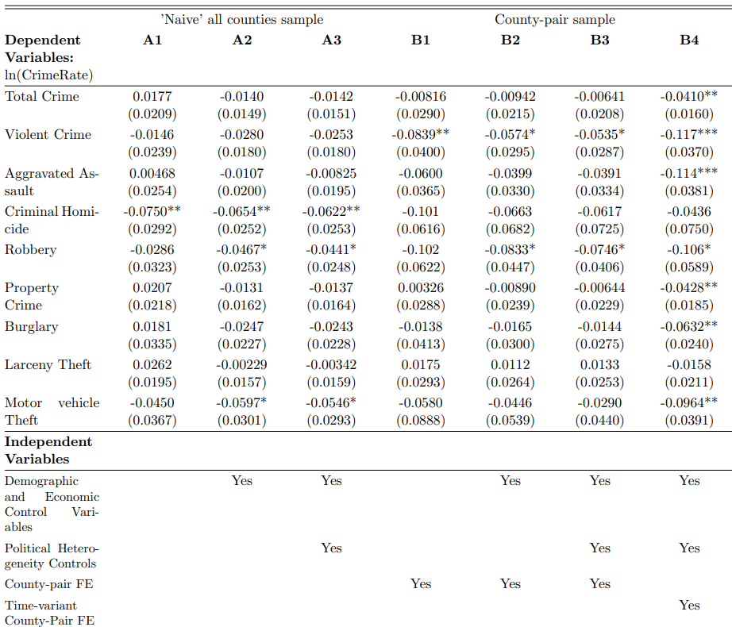
Under our preferred specification (B4), we find that Medicaid expansion led to a 4.1% reduction in total crime (p<0.05), with strong reductions in:
overall violent crime [11.7%] (p<0.01)
aggravated assault [11.4%] (p<0.01)
overall property crime [4.3%] (p<0.05)
burglaries [6.3%] (p<0.05)
motor vehicles theft [9.6%] (p<0.05)
Introduction
Literature Review
Methodology
Data
Results & Checks
Conclusion

Slide 18
Taking stock:
Summary statistics allude to some relative drop in crime in expansion states after Medicaid expansion
Current literature confirms this effect but results are subject to spatial heterogeneity and lack crucial explanatory controls
Our richer model shows that current literature actually underestimates reduction in violent crime but is largely accurate for property crime
Introduction
Literature Review
Methodology
Data
Results & Checks
Conclusion

Slide 19
Taking stock:
Summary statistics allude to some relative drop in crime in expansion states after Medicaid expansion
Current literature confirms this effect but results are subject to spatial heterogeneity and lack crucial explanatory controls
Our richer model shows that current literature actually underestimates reduction in violent crime but is largely accurate for property crime
What about accuracy of transmission mechanisms?
Introduction
Literature Review
Methodology
Data
Results & Checks
Conclusion

Slide 20
Medicaid expansion and crime outcomes: two mechanisms
MECHANISM 1:
Medicaid is effectively a govt transfer programme which:
1) Makes life outside of prison better, by increasing access and consumption of healthcare, which reduces incentive to commit crime [Carr and Peckham, 2019]
2) Provides financial security, by limiting financial exposure to exorbitant medical bills, which reduces the need for crime to make ends meet [Finkelstein et al., 2012]
MECHANISM 2:
Medicaid increases access to treatment for those suffering from behavioural disorders or drug addiction, consequently the substance abuse treatment reduces crime [Bondurant et al., 2018]
Increase to mental health treatment is also shown to result in a moderate crime reduction [Constantine et al. 2012]
Introduction
Literature Review
Methodology
Data
Results & Checks
Conclusion

Slide 21
Extension [1]: White Collar Crime as a Negative Control Test
Channels through which Medicaid expansion influences crime:
Improved health, reduced financial stress, greater access to substance abuse treatment
Primarily affects property and violent crime
More sensitive to changes in economic circumstances and behavioural health
White collar crime:
Premeditated, non-violent offenses where determinants vary from ‘street-level’ crime
Medicaid expansion would not affect white collar crimes
Serves as a valid negative-control test, we expect no effect of expansion
Introduction
Literature Review
Methodology
Data
Results & Checks
Conclusion

Slide 22
Extension [1]: Specification and Results of Negative Control
We do not have access to reported crime data, so we use arrest crime data
Valid assumption insofar as enforcement for white collar crimes is uncorrelated to state’s decision to expand Medicaid
Running our preferred specification (B4), coefficient on β is -0.064 (se: 0.064) (p>0.10)
We indeed get no statistically significant effect, reinforcing our hypothesised transmission mechanism
Introduction
Literature Review
Methodology
Data
Results & Checks
Conclusion

Slide 23
Extension [2]: A Robust Treatment of Spillover Effects
We have 2 different spillover effects to consider:
‘Welfare Magnet Effect’
Individuals with income <138% who live in a non-expansion county might migrate to an adjacent expansion county to gain Medicaid coverage
Cross-border crime
Individuals may cross the border to commit crime due to lower likelihood of being caught. Our regressions use reported crime data so cross-border crime is reflected in the county the crime occured.
We want to understand the way these spillover effects bias our estimators and attempt to control for the effects.
Introduction
Literature Review
Methodology
Data
Results & Checks
Conclusion

Slide 24
Extension [2]: Understanding direction of bias - Migration
The welfare-magnet effect could net bias our estimator in either direction
Low-income individuals MORE crime prone
→ increase in crime rate in expansion county
→ estimator downward bias
Migration
Committing crimes causes loss of Medicaid benefits
→ migration self-selects for low crime individuals
→ decrease in crime rate in expansion county
→ estimator upward bias
Introduction
Literature Review
Methodology
Data
Results & Checks
Conclusion

Slide 25
Extension [2]: Understanding direction of bias - cross-border crime
We expect:
Effect 1 to dominate for violent crime
Effect 2 to dominate for property crime
EFFECT 1
Medicaid expansion causes crime to decrease within county
→ proportional decrease in cross-border crime of individuals in expansion-county
→ no change in cross-border crime of individuals of non-expansion county
→ estimator downward bias
Cross-border crime
EFFECT 2
Committing crimes causes loss of Medicaid benefits
→ individuals in expansion-county choose to now go across the border to commit crime
→ decrease in crime rate in expansion county, increase in crime rate in non-expansion county
→ estimator upward bias
Introduction
Literature Review
Methodology
Data
Results & Checks
Conclusion

Slide 26
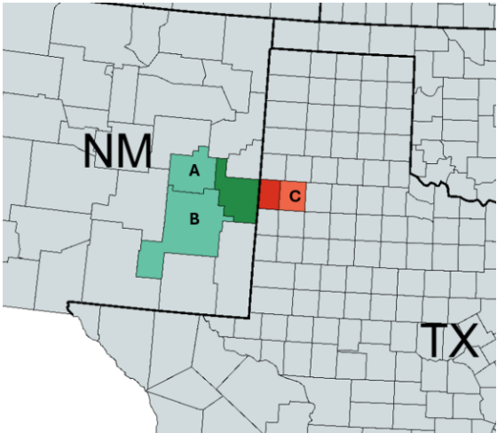
Extension [2]: Formalising “second-layer” model
We take all pairs of “second-layer” counties (e.g. A-B; A-C) and that forms our new dataset.
We then rerun our preferred specification (B4).
Introduction
Literature Review
Methodology
Data
Results & Checks
Conclusion

Slide 27
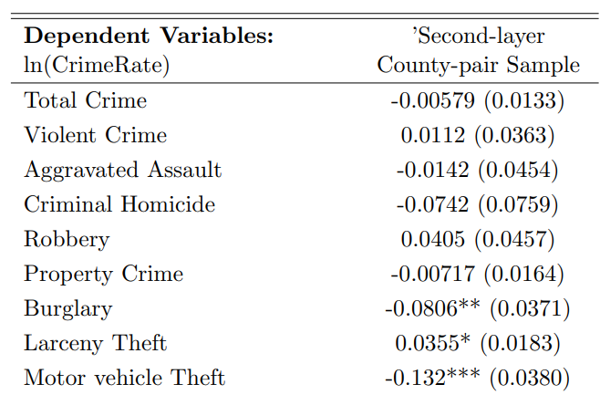
Extension [2]: ‘Spillover-robust’ results and analysis
Since violent crime estimators were assumed downward biased, they should be higher
Yet, they are now insignificant
2. Since property crime estimators were assumed upward biased, they should be lower
Yet, there are now higher in magnitude
Introduction
Literature Review
Methodology
Data
Results & Checks
Conclusion

Slide 28
What have we contributed to the literature?
Inclusion of previously excluded variables
More robust methodology that captures spatial heterogeneity
White-collar crime negative control test to verify transmission mechanism
Careful treatment of spillover effects and a novel “second-layer” county-pair model to obtain ‘spillover-robust’ estimators
Introduction
Literature Review
Methodology
Data
Results & Checks
Conclusion

Slide 29
What work remains to be done?
Use of more complete rape/arson datasets to better capture the full picture
Use of county-level expenditure controls for more precise estimates
Access to a longer time period of reported crime data to capture effect on states that have more recently expanded Medicaid
Combine our results with other studies on Medicaid expansion to do a comprehensive cost-benefit analysis to make an informed decision on Medicaid funding
Introduction
Literature Review
Methodology
Data
Results & Checks
Conclusion

Slide 30
Thank you!
Special thanks to Mr Rhys Williams and Professor Elisa Faraglia for all their help and guidance for my dissertation.

Slide 31
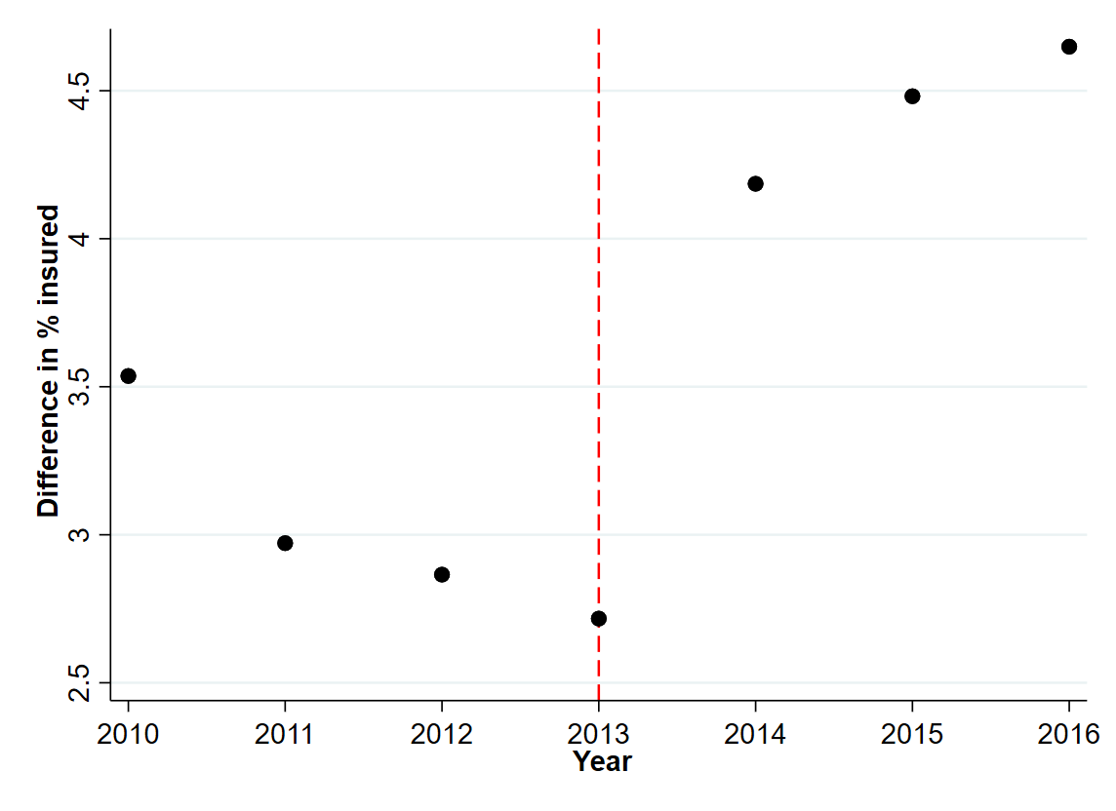
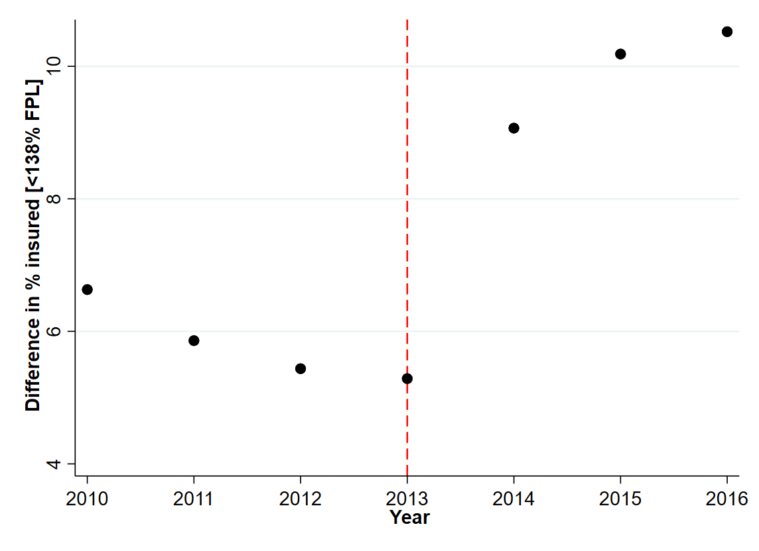
Scatterplot of difference in insured rates (per 100k population) between expansion and non-expansion states for all incomes [left] and those who are <138% FPL [right]:
Note: 2015/2016 expansion states [AK, MT, IN, LA, PA] dropped from plots so as to not conflate trends
Introduction
Literature Review
Methodology
Data
Results & Checks
Conclusion

