Slide 1
Do Central Bank Interventions Limit the Market Discipline from Short-Term Debt?
Viral V. Acharya (NYU)
Diane Pierret (HEC)
Sascha Steffen (ESMT)
International Atlantic Economic Society
Milan, 14 March 2015
Notes:
How does public liquidity affect the provision of private liquidity?
Reliance of banks on shadow banking exposes them to funding risk and discipline
Borrowings in outside market also matter

Slide 2
Motivation
The economy in the Eurozone is still weak and growth is fragile, despite a series of policy interventions by the European Central Bank (ECB).
Deflationary tendencies in the Eurozone might require further action by the ECB.

Slide 3
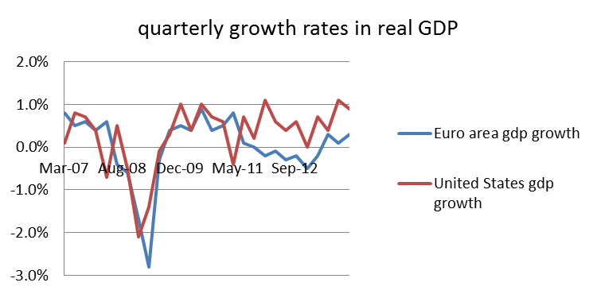
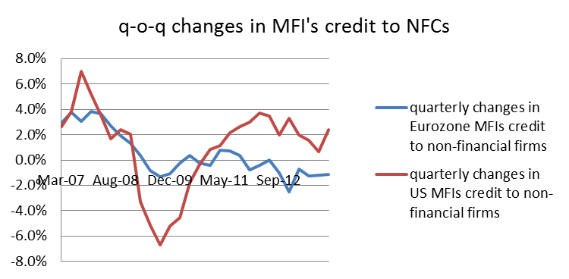
Lending and GDP growth: US vs. Europe
Notes:
Despite ECB interventions during that time, economic growh / credit growth did not pick up...

Slide 4
Motivation
Short-term financing of otherwise highly leveraged banks has been an important catalyst of stress in the banking sector during the recent sovereign debt crisis (Acharya and Steffen, 2015)
ECB responded with LTROs, reducing collateral requirement,...

Slide 5
Research questions
We investigate private short-term funding of European banks during the sovereign debt crisis.
  Did U.S. MMF differentiate between high and low-risk banks?
  Did U.S. MMF differentiate between unsecured and secured investments?
How did MMF respond to ECB interventions?

Slide 6
Main results
Run of U.S. MMF on unsecured funding for high-risk banks in summer 2011
  U.S. MMF maintained unsecured funding and increased repos for low-risk
Market disciplining effect of short-term debt reversed after ECB interventions
  MMF return to high-risk banks

Slide 7
Data
U.S. MMF funding to European banks (iMoneyNet)
  416 MMF to 63 banks
  Nov’10 – Aug’14
Balance sheet and market data (stock returns, CDS) from Bloomberg
Interventions (ECB webpage)

Slide 8
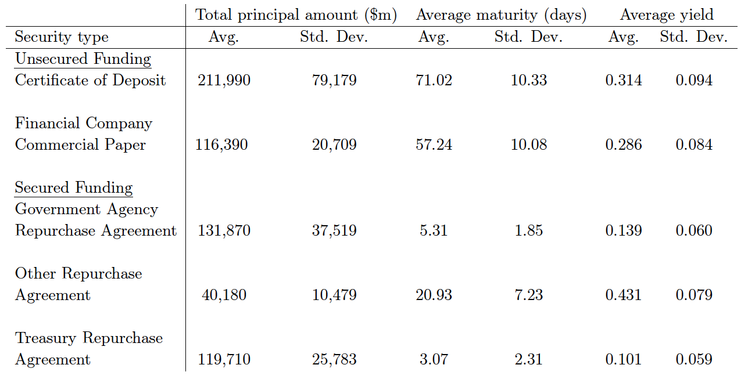
Secured and unsecured funding
Notes:
These are time series averages...

Slide 9
ECB interventions
Securities Markets Programme (SMP) - Aug 2011
  Extension of SMP announced in May 2010; ECB started purchasing
  Italian and Spanish gvt bonds
Long-Term Refinancing Operations (LTRO)
  LTRO 1: ECB allotted EUR 489 billion to 523 banks - Dec 2011
  LTRO 2: EUR 530 billion to 800 banks - March 2012
Outright Monetary Transactions (OMT) - Sept 2012
  following the “whatever it takes” speech
  ECB can purchase unlimited amounts of gvt bonds with a maturity of 1 to 3 years
Forward Guidance - July 2013
  key ECB interest rates expected to remain at present or lower levels

Slide 10
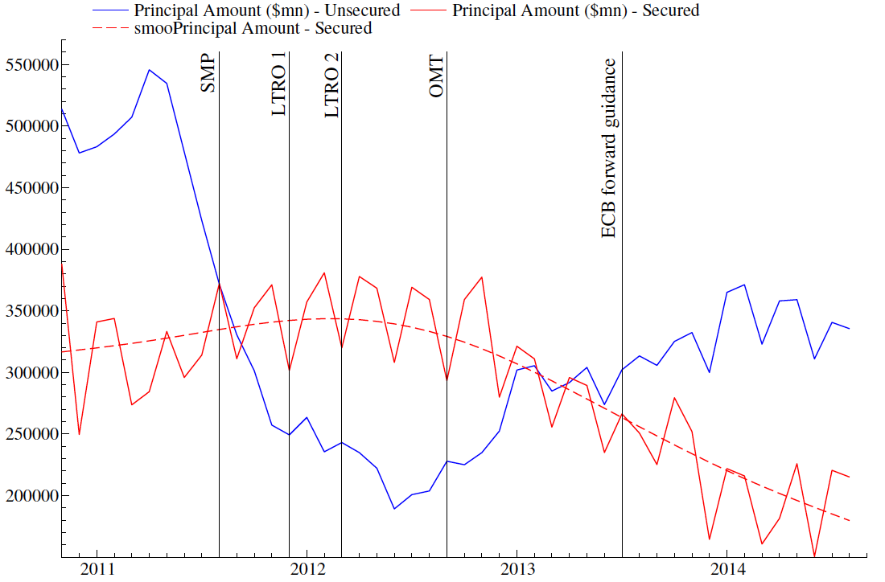
Run on unsecured funding
Vertical bars indicate ECB interventions:
  SMP (08/2011), LTRO 1 (12/2011), LTRO 2 (03/2012), OMT (09/2012), ECB forward guidance (07/2013).

Slide 11
Repo seasonality
Repos drops at end of each quarter and flow back the next month
  Corporate tax payments dates for funds
  Window dressing by European banks that reduce leverage
  Window dressing by MMF removing investments from risky European banks (and invest in Fed’s Reverse Repo Facility)

Slide 12
Market segmentation
Did U.S. MMF reduce risks towards peripheral rather than core-European banks?
We differentiate between (1) GIIPS, (2) non-GIIPS euro area and (3) non-euro area EU banks

Slide 13
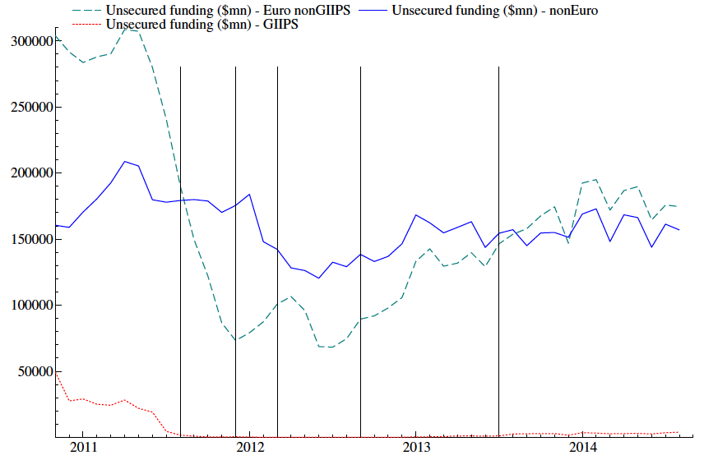
Run on unsecured funding of Eurozone banks
Unsecured funding increases for non-Eurozone EU banks during the crisis.
Reversal of fund flows after ECB interventions.

Slide 14
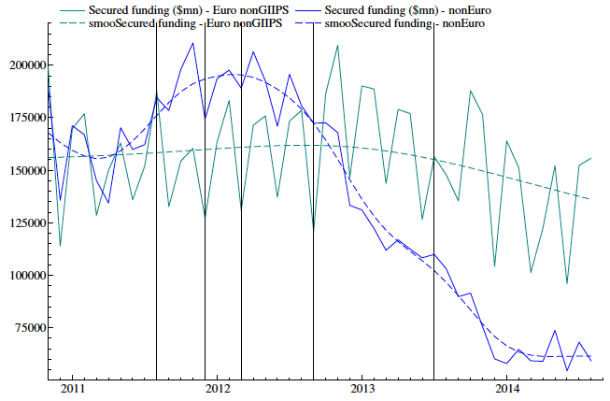
Secured funding for Euro-non GIIPS and non-Eurozone EU banks
End of flight-to-quality after ECB interventions
  MMF flows out of non-Eurozone EU banks

Slide 15
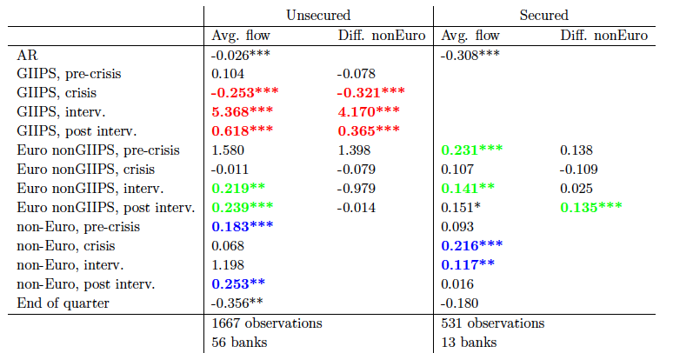
Market segmentation – MMF flows
MMF flows return to Eurozone banks during and post interventions
Notes:
Evidence that US MMF increase their investments in Asian / US banks (?)

Slide 16
Unsecured MMF flows in and out of GIIPS banks

Slide 17
Did U.S. MMF differentiate between bank risk?
“High risk”
  Bank’s 5-year CDS price in Nov 2010 was above the median of all banks 5-year CDS prices in Nov 2010.
Fixing bank risk before crisis period helps identification

Slide 18
Unsecured funds & bank risk
U.S. MMF reduced unsecured investments of high-risk banks relatively more

Slide 19
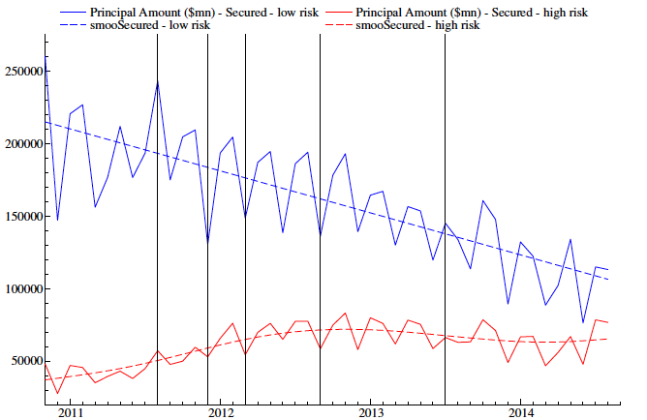
Secured (repo) funding and bank risk
High-risk banks gain access to repo funding during interventions

Slide 20
U.S. MMF flows and bank risk
MMF flow back to high-risk banks after ECB interventions

Slide 21
MMF of high vs. low-risk banks
Is this effect driven by MMF reducing / increasing funding of GIIPS banks?
We drop GIIPS banks from the sample and get the same results
U.S. MMF funding returned to high-risk banks after ECB interventions
  Consistent with a reduction of market discipline

Slide 22
MMF characteristics and fund flows
Increase in haircut on collateral does not affect fund flows
Large funds have larger investments in EU banks
Funds with high exposure to eurozone debt reduce unsecured but increase repo investments

Slide 23
Maturities of U.S. MMF investments
Another way for MMF to reduce risk is by reducing maturities of their investments
We find a significant drop in maturities during 2011
Maturities substantially increased following ECB interventions

Slide 24
Funding pressure in European repo markets
We do not have data related to private repo markets in Europe.
Investigate funding pressure linking ECB interventions to government bond and equity prices
  Event study

Slide 25
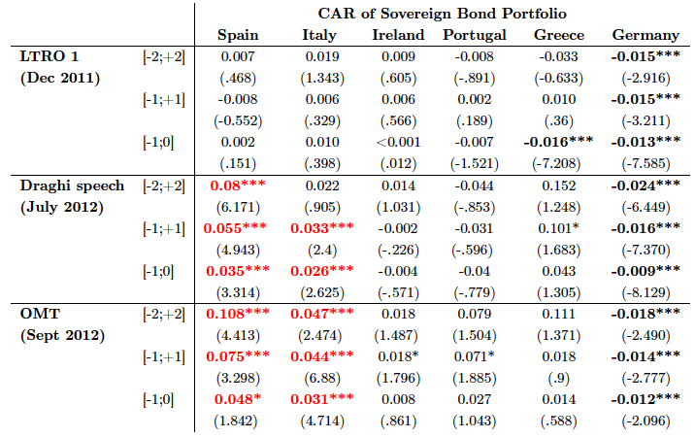
CAR of sovereign bonds around ECB interventions
ECB interventions reduced flight-to-quality and reduced gvt bond yields

Slide 26
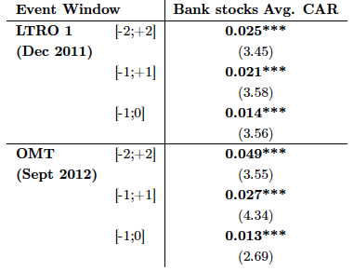
Average CAR of bank equity
Banks have sign AR around LTRO1 and OMT announcement

Slide 27
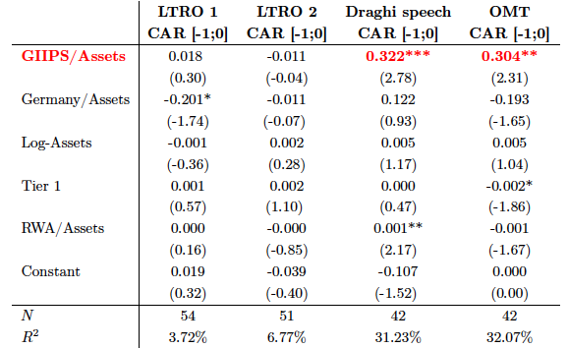
GIIPS holdings explain banks’ CAR
Banks with large holdings of Italian and Spanish gvt bond have higher CARs.

Slide 28
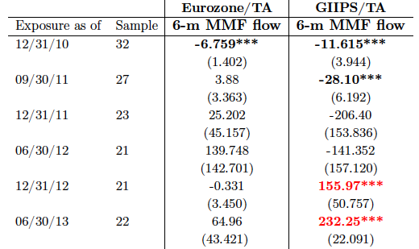
MMF flows and banks’ GIIPS exposure
Banks with GIIPS holdings regain access to U.S. MMF

Slide 29
Bringing it all together…
Run of U.S. MMF on unsecured funding for high-risk banks in summer 2011
  U.S. MMF maintained unsecured funding and increased repos for low-risk
Market disciplining effect of short-term debt reversed after ECB interventions
  MMF return to high-risk banks
Notes:
ECB policy reduced exposure to funding risk and discipline when banks are financed by shadow banking sector.
ECB provided „deposit like insurance“ for shadow banking sector....

Slide 30
Policy Implications
ECB interventions reduced pressure on national competent authorities to act and reduce risk of national banks
  Forbearance
Comprehensive assessment of the ECB tried to address this and recapitalize the weak banks across Europe
  AQR and stress might not have been sufficient to achieve that (Acharya and Steffen (2014 a,b), Steffen (2014))
Implications for stability of the banking union?
Notes:
Implications for stability: what happens when disciple and funding risk return and banks‘ balance sheets are still bloated with risky (dodgy) assets?

Slide 31
Backup Slides

Slide 32
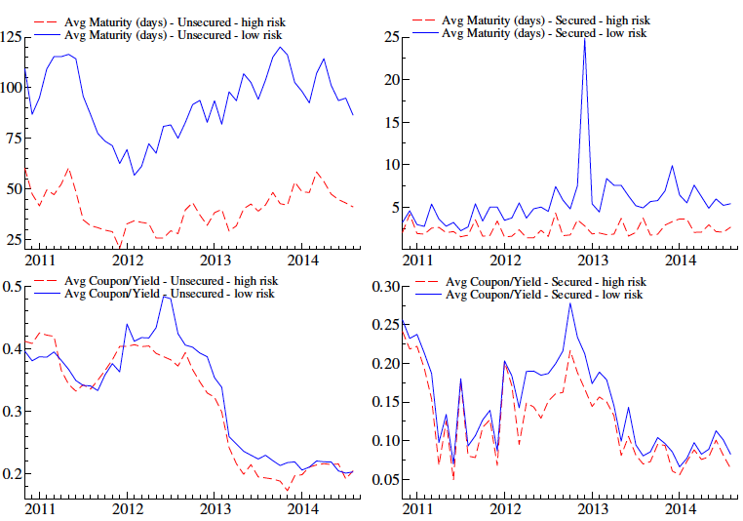

Slide 33
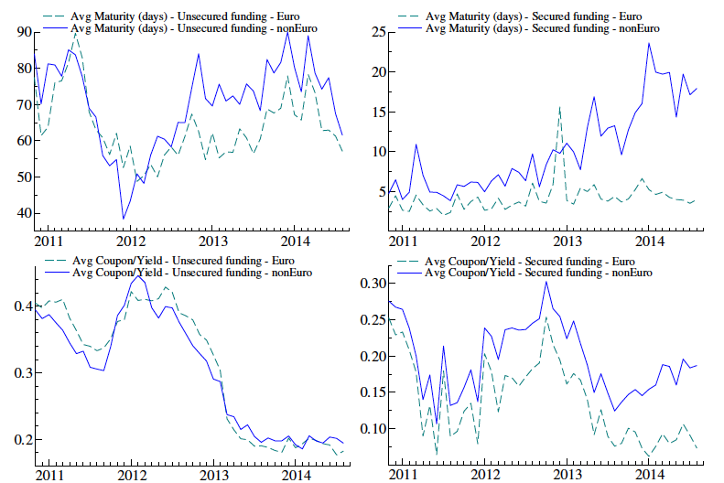
U.S. MMF reduced maturities of unsecured funding in 2011

