Slide 1
SEVENTY-SEVENTH INTERNATIONAL
ATLANTIC ECONOMIC CONFERENCE
MADRID 2-5 APRIL 2014

Slide 2
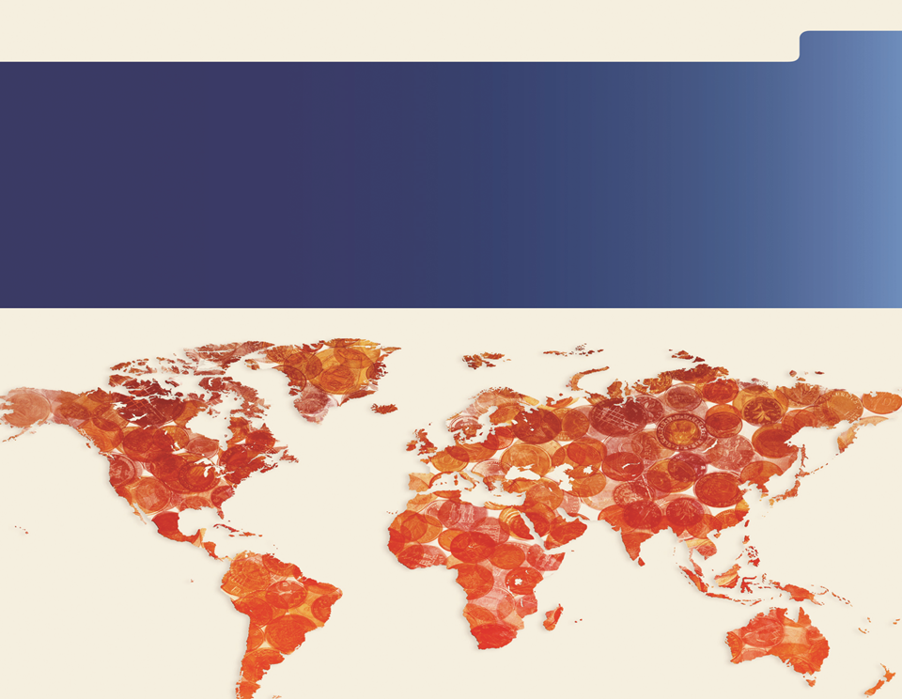
Asli Demirguc-Kunt
Director of Research
World Bank Group
Financial Inclusion

Slide 3
Why financial inclusion ?
Intro Measurement and Impact Public Policy Focus Areas Main Messages
Increased policy interest
Over 50 countries: formal targets and strategies for financial inclusion
WBG President: has called for achieving universal financial access by 2020
Critical role in reducing poverty, boosting shared prosperity
Enables poor people to save and borrow, allowing them to build assets, invest in education and entrepreneurial ventures, thus improving their livelihoods
New empirical evidence on financial inclusion and its effects
Notes:
Financial inclusion has moved up the policy agenda. It has become a subject of considerable interest in international forums, such as the G-20. At the country level, about two-thirds of regulatory and supervisory agencies are now charged with enhancing financial inclusion. In recent years, 52 countries have committed to formal targets for financial inclusion, and have formulated explicit financial inclusion strategies. During the recent Annual Meetings, the World Bank Group President Jim Yong Kim announced an ambitious target of universal financial access by the year 2020.
The increased emphasis on financial inclusion reflects a growing realization of its potentially transformative power to accelerate development gains. Inclusive financial systems provide individuals and firms with greater access to resources to meet their financial needs, such as saving for retirement, investing in education, capitalizing on business opportunities, and confronting shocks.
Financial inclusion is important for economic development, because it enables poor people to save and borrow, allowing them to build assets, invest in education and entrepreneurial ventures, and thus improve their livelihoods. It plays a critical part in sustainable development, reducing poverty, boosting shared prosperity.
We can now illustrate this better with improved theoretical models, which illustrate how financial market frictions generate poverty traps and slower growth.
Moreover, we now have much more empirical evidence on financial inclusion and its effects around the world.

Slide 4
Intro Measurement and Impact Public Policy Focus Areas Main Messages
Global views: Financial Development Barometer
Source: Financial Development Barometer (poll of financial sector officials and experts from 21 developed and 54 developing economies).
Notes:
The left-hand donut chart…. under the “new technologies”, the survey explicitly mentioned mobile banking and biometric borrower identification
The right-hand donut chart….
- the “more competition” category combines “policies promoting competition from foreign banks” and “policies promoting competition from domestic banks”
- the “better legal framework and credit information category” combines “better legal framework” and “policies to improve credit information”

Slide 5
Defining financial inclusion
Intro Measurement and Impact Public Policy Focus Areas Main Messages
Financial inclusion = share of individuals and firms that use financial services
… does not mean finance for all at all costs
Some have no demand or need for financial services
But for many, the use of financial services is constrained by market and government failures
That is why it is important to measure not only actual use of financial services, but also the barriers to access
Notes:
Examples of market failures: asymmetric information, consumers' and providers’ departures from rationality,…

Slide 6
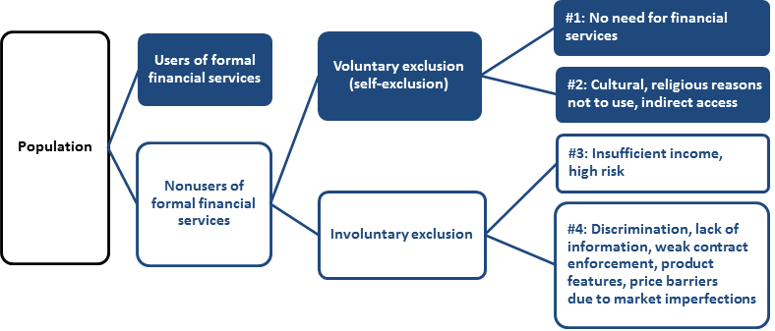
Defining financial inclusion
Intro Measurement and Impact Public Policy Focus Areas Main Messages
Notes:
Financial inclusion = share of individuals and firms that use financial services
… does not mean finance for all at all costs
Some have no demand or need for financial services
But for many, the use of financial services is constrained by market and government failures
That is why it is important to measure not only actual use of financial services, but also the barriers to access
Examples of market failures: asymmetric information, consumers' and providers’ departures from rationality,…
This chart illustrates the distinction between the use of and access to financial services.
Actual use is easier to observe empirically. Some individuals and firms may have access to, but choose not to use some financial services. Some may have indirect access, for example, by being able to use someone else’s bank account. Others may not use financial services because they do not need them or because of cultural or religious reasons. The nonusers include individuals who prefer to deal in cash and firms without promising investment projects. From a policy maker’s viewpoint, nonusers do not constitute an issue because their nonuse is driven by lack of demand. However, financial literacy can still improve awareness and generate demand. Also, nonuse for religious reasons can be addressed by allowing the entry of financial institutions that offer, for instance, Shari’a-compliant financial services.
Some customers may be involuntarily excluded from the use of financial services. This is illustrated by the “involuntary exclusion” box in figure 1.1. Several groups belong to this category. One notable group consists of individuals and firms that are unbankable from the perspective of commercial financial institutions and markets because they have insufficient income or represent an excessive lending risk. In this case, lack of use may not be caused by market or government failure. Other groups in this category may not have access because of discrimination, lack of information, shortcomings in contract enforcement, a poor information environment, shortcomings in product features that may make a product inappropriate for some customer groups, price barriers because of market imperfections, ill-informed regulations, or the political capture of regulators. If high prices exclude large parts of the population, this may be a symptom of underdeveloped physical or institutional infrastructure, regulatory barriers, or lack of competition. Financial exclusion deserves policy action if it is driven by barriers that restrict access by individuals for whom the marginal benefit of using a financial service would otherwise be greater than the marginal cost of providing the service.
In considering involuntarily excluded users, one must distinguish between those individuals facing price barriers and financial exclusion arising because of high idiosyncratic risk or poor project quality (those people identified as group #3 in the figure) and those individuals facing such barriers because of market imperfections such as asymmetric information (group #4 in the figure).

Slide 7
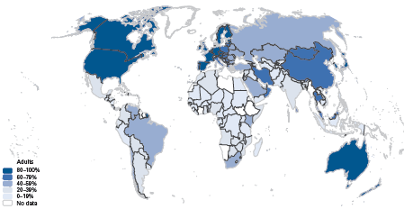
Measuring financial inclusion
Intro Measurement and Impact Public Policy Focus Areas Main Messages
Globally, about 50 % of adults have a bank account
The other 50 % (2.5 billion) remain “unbanked”
Adults with accounts at a formal financial institution
Source: Global Financial Inclusion (Global Findex) Database, worldbank.org/globalfindex
Notes:
Mention that 22 % of adults made new savings/deposits with financial institution, and 9 % received new loans in 2011.
Simply having an account does not guarantee that it will be regularly used. It is possible to create many new accounts but their real-world impact is small if they simply lie dormant. In the report, we also show a different map, illustrating frequency of use around the world.

Slide 8
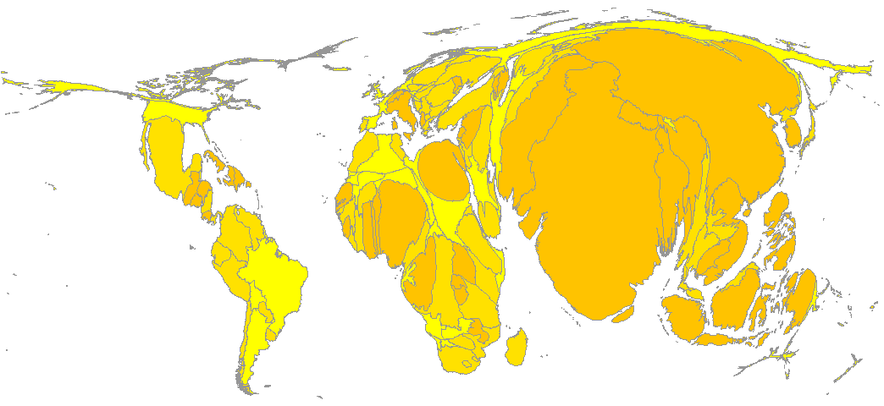
Where do the unbanked live?
Intro Measurement and Impact Public Policy Focus Areas Main Messages
Source: Global Financial Inclusion (Global Findex) Database, worldbank.org/globalfindex
Notes:
Country sizes are adjusted to reflect the estimated numbers of unbanked people (people 15 and above).

Slide 9
Measuring financial inclusion
Intro Measurement and Impact Public Policy Focus Areas Main Messages
Not all “unbanked” need financial services, but barriers play a key role
Notes:
What are the (self-reported) reasons for not having a bank account? As illustrated in this chart, the reason most frequently cited for not having a formal account is the lack of enough money to have and use one. This is the response given by 65 percent of adults who are without a formal account; 30 percent cite this as the only reason. The next most commonly cited reasons for not having an account are the expense of banks or accounts and the fact that another family member already has an account. The other reasons reported are the excessive distance of banks, a lack of the necessary documentation, a lack of trust in banks, and religious reasons.
Twenty percent of unbanked respondents cited distance as a key reason as to why they did not have a formal account. The frequency with which this barrier was cited increases sharply as one moves down the income level of countries, from 10 percent in high-income economies to 28 percent in low-income economies. Among developing economies, there is a significant relationship between distance as a self-reported barrier and objective measures of providers such as bank branch penetration. To illustrate this point: Tanzania has a large share of non–account-holders who cite distance as a reason they do not have an account—47 percent—and also ranks near the bottom in bank branch penetration, averaging less than 0.5 bank branches per 1,000 square kilometers.

Slide 10
Correlates of financial inclusion
Intro Measurement and Impact Public Policy Focus Areas Main Messages
Source: Based on Allen, Demirguc-Kunt, and others (2012)
Notes:
What can data on some 124,000 people tell us about the drivers of financial inclusion? The massive dataset underlying the Global Findex database provides a unique source of information on what drives financial inclusion around the world. Allen, Demirgüç-Kunt, and others (2012) subject the dataset to a battery of statistical tests to address the question of what drives financial inclusion.
The results are illustrated by this chart, which shows results from a probit regression of a financial inclusion indicator on country fixed effects and a set of individual characteristics, for 124,334 adults (15 years and older) covered by the Global Findex database in 2011.
The analysis considers a host of other country-level characteristics and policies as potential determinants of account use. The analysis focuses on three indicators of account use: (1) ownership of an account, (2) use of the account to save, and (3) frequent use of the account, defined as three or more withdrawals per month. We find that these indicators are associated with a better enabling environment for accessing financial services, such as lower banking costs, greater proximity to financial providers, and fewer documentation requirements to open an account. People who are poor, young, unemployed, out of the workforce, less well educated, or who live in rural areas are relatively less likely to have an account. Policies targeted at enhancing financial inclusion—such as offering basic or low-fee accounts, granting exemptions from onerous documentation requirements, allowing correspondent banking, and using bank accounts to make government payments—are especially effective among those people who are most likely to be excluded: the poor and rural residents.
Note: the financial inclusion indicator is a 0/1 variable indicating whether a person had an account at a formal financial institution in 2011.
For definitions, data sources, standard errors of the parameter estimates, additional estimation methods, and additional regressions for other dependent variables (savings and the frequency of use of accounts), see Allen, Demirgüç-Kunt, and others (2012).

Slide 11
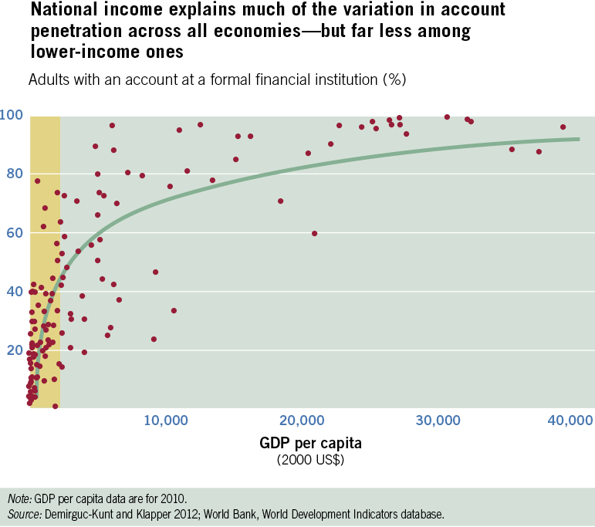
Intro Measurement and Impact Public Policy Focus Areas Main Messages
Notes:
Without a doubt, national income, approximated by GDP per capita, explains much of the variation in account penetration around the world, as illustrated in this chart.
Above a GDP per capita of $15,000, with only a few exceptions, account penetration is virtually universal.
Indeed, regression analysis shows that national income explains about 70 percent of the variation among the world’s economies in the share of adults with a formal account.
However, among the bottom 50 percent of the income distribution in the sample (economies with a GDP per capita below $2,200), the relationship between GDP per capita and account penetration is much weaker. When the analysis is restricted to the bottom 50 percent of economies by income level, GDP per capita explains only 22 percent of the variation in account penetration among economies. This suggests that the variation across economies is not determined solely by national income as approximated by GDP per capita.

Slide 12
Financial inequality and economic inequality
Intro Measurement and Impact Public Policy Focus Areas Main Messages
Source: Calculations based on Demirgüç-Kunt and Klapper 2012; World Development Indicators database, World Bank.
Note: Higher values of Gini mean more inequality. Data on Gini are for 2009 or the latest available year. Account penetration is share of adults who had an account at a formal financial institution in 2011.
Notes:
What can we say about the linkage between financial inclusion and shared prosperity?
We need more data to be able to come up with very strong conclusion, but the early calculations illustrated here suggest that there is a strong correlation between inequality in the use of formal accounts and general income inequality as measured by the Gini coefficient (with higher values indicating higher income inequality).
Let me illustrate this by the contrasting situations in two countries.
In Sweden, which has one of the lowest Gini coefficients (25), account penetration in the poorest income quintile is essentially the same as in the richest (resulting in a value of close to 1 on the vertical axis).
In Paraguay, at the other end of the spectrum with a Gini coefficient of 52, there is a large gap in account penetration: only 4 percent of adults in the poorest quintile have a formal account, compared with 51 percent in the richest (resulting in a value of about 13 on the vertical axis).

Slide 13
Evidence on impacts of financial inclusion
Intro Measurement and Impact Public Policy Focus Areas Main Messages
Empirical evidence on impact varies by the type of financial services
Basic payments, savings: strong evidence on benefits, especially for the poor
Insurance products: also some evidence of a positive impact
Access to credit: mixed picture
firms: a positive effect on growth, especially start ups, small and medium enterprises
microenterprises and individuals: evidence on benefits for smoothing consumption, but not always for entrepreneurial ventures
Notes:
For the microenterprises and individuals, the evidence comes from dozens of microcredit experiments as well as from other cross-country research. See for example Roodman (2011) and Bauchet and others (2011)

Slide 14
Financial inclusion policy – overall findings from research
Intro Measurement and Impact Public Policy Focus Areas Main Messages
Policy should focus on addressing market and government failures
Not on promoting financial inclusion for inclusion’s sake, and certainly not on making everybody borrow
Direct government interventions in credit markets tend to be politicized and less successful, particularly in weak institutional environments
Role for government in creating legal and regulatory framework
Examples: protecting creditor rights, regulating business conduct, overseeing recourse mechanisms to protect consumers
Notes:
The overall message from research is rather clear: policy should focus on addressing market and government failures, not on promoting financial inclusion for inclusion’s sake, and certainly not on making everybody borrow. Direct government interventions in credit markets tend to be politicized and less successful, particularly in weak institutional environments.
The government has an important role in creating legal and regulatory framework. This means, for example, protecting creditor rights, regulating business conduct, overseeing recourse mechanisms to protect consumers.

Slide 15
Intro Measurement and Impact Public Policy Focus Areas Main Messages
Financial inclusion policy – overall findings from research
Competition policy: important part of consumer protection
Healthy competition among providers increases consumers’ market power
New evidence: lack of bank competition diminishes firms’ access to finance
Source: Love and Martinez Peria 2012
Notes:
The chart shows new evidence on the link between bank competition and firms’ access to finance, combining multi-year firm-level surveys with panel country-level data on bank competition for 53 countries.
Specifically, the chart shows the slope coefficient from a probit regression, explaining the probability of a firm having access to finance (a bank loan, line of credit, or overdraft) as a function of mark-up in the banking sector (approximated by Lerner index), controlling for other factors. Higher Lerner index means lower competition, so a negative estimate in this chart means that lower competition is associated with lower firm access to finance.
This negative effect gets stronger with lower financial development, worse credit information, and higher share of government banks. The chart illustrates this by showing the slope coefficient at the level corresponding to the least-developed financial system (measured by private sector credit to GDP), the lowest availability of credit information (0 in “Doing Business”), and the highest degree of government ownership (100 percent for fully government-owned banking system), respectively.
Notes:
Access to finance … dummy variable equal to 1 if the firm has access to bank finance (loan, overdraft or line of credit) from World Bank Enterprise Surveys.
Financial development … domestic credit to the private sector (fraction of GDP) from WDI.
Credit information index … depth of credit information index is a measure of the coverage, scope and accessibility of credit information available through either a public credit registry or a private credit bureau, both by law, and in practice. (0-6) obtained from Doing Business Indicators.
Share of government-owned banks fraction of banking system's assets in banks that are 50% or more government-owned from the World Bank Regulation and Supervision Survey.

Slide 16
Intro Measurement and Impact Public Policy Focus Areas Main Messages
Financial inclusion policy – overall findings from research
Role in supporting information environment (standards for disclosure, transparency, promoting credit bureaus, collateral registries)
Source: Love, Martínez Pería, and Singh 2013.
Notes:
Note: Based on firm-level surveys in 73 countries, the study compares the access of firms to credit in seven countries that have introduced collateral registries for movable assets against the access of firms in a sample of countries matched by region and income per capita.
Sources: Doing Business, Enterprise Surveys, calculations by Love, Martínez Pería, and Singh (2013).

Slide 17
Promoting financial inclusion: focus areas
Intro Measurement and Impact Public Policy Focus Areas Main Messages
Promoting financial inclusion
I. Promise of technology
II. Product design, business models
III. Financial capability
Notes:
Against this broader policy context, let me now focus on three areas: (1) the potential of new technology to increase financial inclusion; (2) the role of product design and business models; and (3) the role of financial literacy, financial capability, and business training.
The report’s emphasis of these topics reflects the impact these areas can have on financial inclusion and shared prosperity, as well as the fact that there is new evidence to highlight.
Let me also add that these three areas can reinforce each other. For example, new technology can be used not only to boost financial inclusion, but also to improve product design and strengthen financial capability (as examined in the studies on the use of text messages to promote savings behavior that are referenced in chapter 2 of the report).

Slide 18
I. Promise of technology
Intro Measurement and Impact Public Policy Focus Areas Main Messages
Technological innovations reduce transaction costs, increase financial security
Scope for scaling up, illustrated e.g. by growth in phone subscriptions
Source: World Development Indicators.
Notes:
Examples of technological innovations: mobile payments, mobile money, use of biometric information for borrower identification
Note: by “biometric information” we mean fingerprinting, iris scans, and other techniques. These are now increasingly used for example for borrower identification.

Slide 19
I. Promise of technology
Intro Measurement and Impact Public Policy Focus Areas Main Messages
Example: fingerprinting in Malawi (% of balances repaid on time)
Source:
Calculations based on Giné, Goldberg, and Yang (2012).
Notes:
Recent innovations in technology
Mobile payments, mobile banking
Borrower identification using biometric data (fingerprinting, iris scans, …)
… can help reduce transaction costs while increasing financial security as demonstrated in the chart.
In the experiment, farmers in Malawi who applied for agricultural input loans to grow paprika were randomly assigned to either a control group, or a treatment group where each member had a fingerprint collected as part of the loan application.
The chart shows the repayment rates among fingerprinted (dark blue) and control (light blue) groups by quartiles of the ex-ante probability of default. Individuals in the "worse" quintile are those with highest probability of default, and those for whom fingerprinting had the largest (and statistically significant) effect.
The study finds that fingerprinting led to substantially higher repayment rates for the subgroup of borrowers with the highest ex ante default risk. This suggests that fingerprinting, by improving personal identification, enhanced the credibility of the lender’s dynamic incentive, that is, the threat of denying credit based on earlier repayment performance. The impact of fingerprinting on repayment in the highest default risk subgroup (20 percent of borrowers) is large. By contrast, fingerprinting had no impact on repayment among farmers with low ex ante default risk.

Slide 20
I. Promise of technology
Intro Measurement and Impact Public Policy Focus Areas Main Messages
To harness the promise of new technologies…
…. regulators need to allow competing financial service providers and consumers to take advantage of technological innovations…
…coupled with strong prudential regulation and supervision to prevent overextension.

Slide 21
II. Product design, business models
Intro Measurement and Impact Public Policy Focus Areas Main Messages
Product design that addresses market failures, meets consumers’ needs and overcomes behavioral problems can foster wider use of financial services
Example 1: commitment accounts
Note: The exchange rate was MK145/USD during the study period.
Source: Brune, Giné, and others (2011).
Notes:
Product design that addresses market failures, meets consumers’ needs and overcomes behavioral problems can foster wider use of financial services
Examples include: commitment accounts, reminders, labeled accounts, group lending, investment games, timing of repayments, index-based insurance
Let me focus here on two example. The first one, illustrated on this slide, are commitment accounts
Randomized evaluation in Malawi (Brune et al 2011) shows that commitment “treatment” led to increases in bank deposits and caused increases in agricultural input use, crop sales, and household expenditures over the next agricultural year
Interestingly, the commitments seemed primarily to have helped farmers by shielding funds from their social network

Slide 22
II. Product design, business models
Intro Measurement and Impact Public Policy Focus Areas Main Messages
Example 2: index insurance
New evidence: lack of trust, liquidity constraints constrain demand (field experiment in India by Cole and others, 2012)
What helps: designing products to pay often and fast, an endorsement by a well-regarded institution, simplification and consumer education
Source: Giné and Yang, 2009
Notes:
As the second example, let me tell you about the puzzling case of index insurance.
On the face of it, index insurance makes a lot of sense. It has clear benefits for lenders (lower risk of weather-related credit defaults), potential to increase financial inclusion and agricultural production.
But in practice, take-up has often been low. For example, in a randomized experiment with farmers in Malawi, Gine and Yang (2009) found that 20% for loans with rainfall insurance vs. 33% for loans without insurance.
New evidence: lack of trust and liquidity constraints are significant non-price frictions that constrain demand (field experiment in India by Cole and others, 2012)
What has been shown to help: designing products to pay often and fast, an endorsement by a well-regarded institution, simplification and consumer education.

Slide 23
II. Product design, business models
Intro Measurement and Impact Public Policy Focus Areas Main Messages
Example of an innovative business model: Banco Azteca, Mexico
Improved access can be achieved by leveraging existing relationships
Source: Bruhn and Love (forthcoming)
Notes:
Beyond product design, improvements in lending to micro and small firms can be achieved by leveraging existing relationships
One of the many examples of innovative business model comes from Mexico.
In 2002, Banco Azteca opened >800 branches in stores of its parent company (Groupo Electra), a consumer goods retailer caters to low and middle-income groups mostly excluded from commercial banking.

Slide 24
III. Financial capability
Intro Measurement and Impact Public Policy Focus Areas Main Messages
Classroom-based financial education for general population do not work
Financial literacy can be increased by well-designed, targeted interventions
More likely to work in “teachable moments” (e.g., new job, new mortgage)
Especially beneficial for people with limited financial skills
It helps to leverage social networks (e.g., involve both parents and children)
“Rule of thumb” training helps by avoiding information overload
New delivery channels show promise—example: messages in soap operas
Notes:
Research shows that standard, classroom-based financial education programs aimed at general population do not work, at least not for adults
In microenterprises, business training programs have been found to lead to improvements in knowledge, but relatively small impact on business practices and performance
Recent evidence suggests that financial literacy can be increased by well-designed, targeted interventions
The interventions are more likely to work during “teachable moments”, such as starting a job or purchasing a new financial product, such as mortgage
Also, we find that these interventions tend to be especially beneficial for people with limited financial skills
It also helps to leverage social networks. For example, involve both parents and children, or both senders and recipients of remittances.
Finally, research emphasizes the importance of the delivery mode.
It points to a role for “rule of thumb” training, which helps by avoiding information overload
It also shows a promising role for new delivery channels. One example of such channel is inserting financial literacy messages into soap operas.
A recent study, done with contribution from World Bank staff, entailed the content development, production, and impact evaluation of financial capability story lines that were included in a popular South African soap opera, “Scandal!”. The soap opera has been running four episodes a week for eight years (more than 1,500 episodes). It is broadcast on the second-most watched station in South Africa—the show reaches approximately 3 million viewers—and has been especially popular among low-income South Africans. The financial education story line stretched over two consecutive months, a time span deemed necessary by social marketing specialists for the viewers to connect emotionally with the characters, for the events to unfold, and for the financial literacy messages to sink in. The financial education messages in the story line were tested through focus groups to ensure that they would be correctly understood by the target group, that the plot appeared realistic, and that the target group could identify with the characters and their problems. All changes suggested by the focus group members were included in the final story line. The development and production of the story line lasted for eight months and cost approximately $90,000.
To evaluate the impact of the project, a randomized encouragement design methodology with the following key components was used. A financial incentive was provided to half of the sample (the randomly selected treatment group) to encourage the participants to watch “Scandal!” A financial incentive of the same amount was provided to the other half of the sample (the randomly selected control group) to watch a soap opera that is similar in terms of content and viewership profile and that airs around the same time, but that did not have a financial literacy component. Two phone-based surveys were conducted. A final face-to-face survey probed the longer-term effects of the soap opera four months after the financial literacy episodes had been broadcast.

Slide 25
III. Financial capability
Intro Measurement and Impact Public Policy Focus Areas Main Messages
Financial literacy messages seem to have a real-world effect…
… but the effect is short-lived – need to repeat / reinforce
Source: Berg and Zia (2013)
Notes:
The impact evaluation found substantial improvements in content-specific financial knowledge, a greater affinity for formal borrowing, less affinity for hire purchase agreements (which spread the cost of an expensive item over a period of time at a high interest rate), and a decline in gambling (Berg and Zia 2013). The possible negative consequences of hire purchase and gambling were highlighted in the soap opera story line: the main character ended up in considerable financial distress because of a hire purchase transaction and gambling.
The results of the final face-to-face survey show that respondents in the treatment group were substantially less likely to have signed a hire purchase agreement or to have gambled during the previous six months (respectively, 19 percent and 31 percent in the control group vs. 15 percent and 26 percent in the treatment group). The heterogeneous effects were strongest among the respondents with low initial financial literacy and low formal educational attainment. The complementary qualitative analysis confirmed these findings and highlighted some key gender differences in the way men and women think about borrowing: women generally take on debt as a last resort, while men are more willing to borrow for purchases.
Note: “Hire purchase” refers to contracts where people pay for goods in installments

Slide 26
Main messages
Intro Measurement and Impact Public Policy Focus Areas Main Messages
Financial inclusion: critical role in sustainable development, reducing poverty, boosting shared prosperity
Financial inclusion varies widely around the world; poor people and young and small firms face the greatest barriers
Innovative technologies, services, business models, and delivery channels hold much promise for increasing financial inclusion
The role of policy is to address market and government failures, not to increase inclusion for inclusion’s sake
Key areas: strengthening regulations, improving information environment, ensuring competition among providers, educating & protecting customers.

